Slide 1
DeToks: Decentralised Social Media
using 5G NAT puncturing
Orestis Kanaris
Johan Pouwelse, Supervisor

Slide 2
Introduction
Depletion of IPv4 addresses
and lack of cybersecurity
“forced“ 5G network operators
to violate Internet protocols.

Slide 3
Introduction
Started with configurable
home network NAT boxes
Devices became hard to root
Carriers adopted centralized
Carrier-Grade NATs

Slide 4
Introduction
Freedom of communication online
is decreasing
Phones are designed to only
communicate with the cloud
Discoverability of peers is facilitated only
by conglomerates

Slide 5
Introduction
Applications are controlled by few
Social media is a monopoly
AI training has a huge barrier to entry

Slide 6
Problem Description
We want to re-decentralize the internet by overcoming restricted communications in cellular networks with symmetric NATs on user’s space networking on phones with their original OS
Notes:
The term user space refers to all code that runs outside the operating system’s kernel. User space usually refers to the the various programs and libraries that the OS system uses to interact with the kernel. Software that performs input/output, manipulates file system objects, application software etc. In this case we are talking networking through an application running on the original OS (in the examples is the android os that the phones were shipped with )

Slide 7
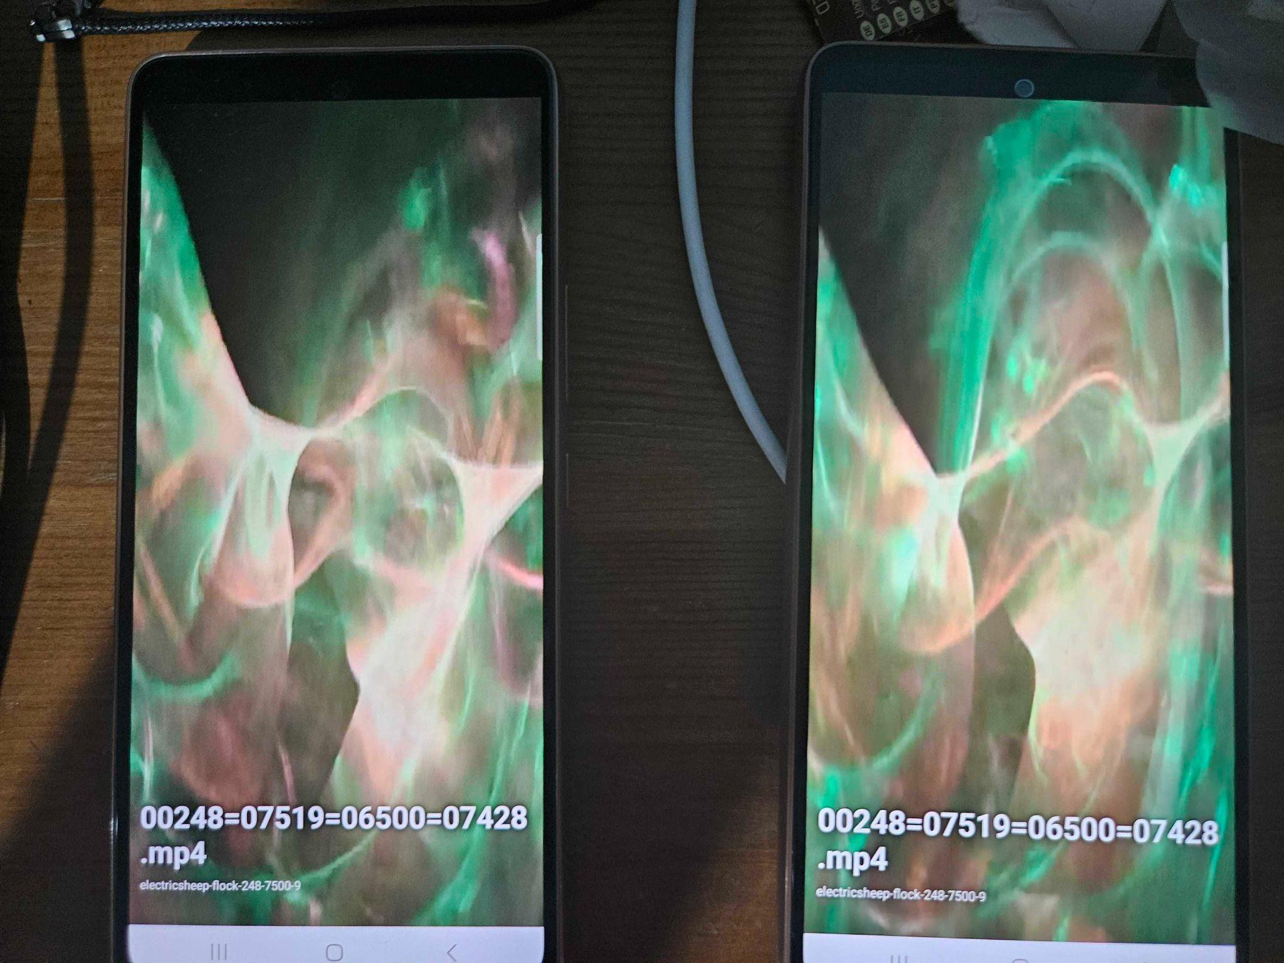
Solution
DeToks:
Tribler lab’s Distributed TikTok-like
Social Media app

Slide 8
Solution
DeToks:
Swip-based Navigation
Content prefetching from Bittorrent
Gosip-based content discovery
Forms a phone-to-phone overlay on 4G/5G

Slide 9
But…
IPv8,the protocol behind DeToks could be improved in terms of distributed NAT puncturing
And we thought of making the improvement
a standalone open-source library
Hence why we are all gathered here

Slide 10
Network Address Translator (NAT)

Slide 11
Network Address Translator (NAT)
Used to preserve IPv4 addresses

Slide 12
Network Address Translator (NAT)
Used to preserve IP addresses
Allows multiple devices to share a single public IP address

Slide 13
Network Address Translator (NAT)
Used to preserve IP addresses
Allows multiple devices to share a single public IP address
Maps external IP-port pairs to internal

Slide 14
Network Address Translator (NAT)
Used to preserve IPv4 addresses
Allows multiple devices to share a single public IP address
Maps external IP-port pairs to internal
Concerves IPv4 addresses

Slide 15
Network Address Translator (NAT)
Used to preserve IPv4 addresses
Allows multiple devices to share a single public IP address
Maps external IP-port pairs to internal
Concerves IPv4 addresses
4 types of NAT

Slide 16
Network Address Translator (NAT)
Used to preserve IPv4 addresses
Allows multiple devices to share a single public IP address
Maps external IP-port pairs to internal
Concerves IPv4 addresses
4 types of NAT
Symmetric NAT ⇒ Hardest to Penetrate

Slide 17
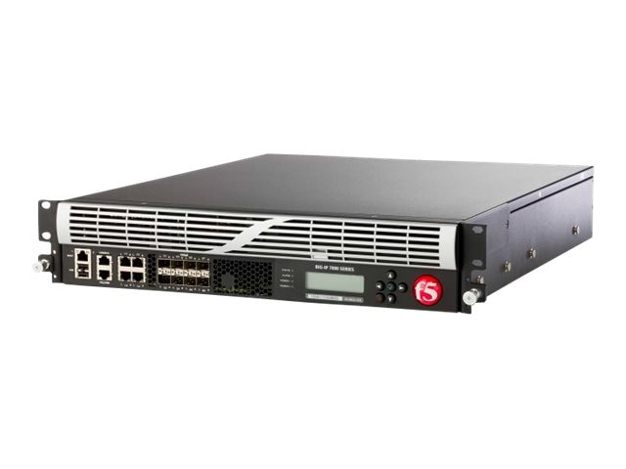
Network Address Translator (NAT)
Used to preserve IPv4 addresses
Allows multiple devices to share a single public IP address
Maps external IP-port pairs to internal
Concerves IPv4 addresses
4 types of NAT
Symmetric NAT ⇒ Hardest to Penetrate
The demon box (carrier-grade NAT)

Slide 18
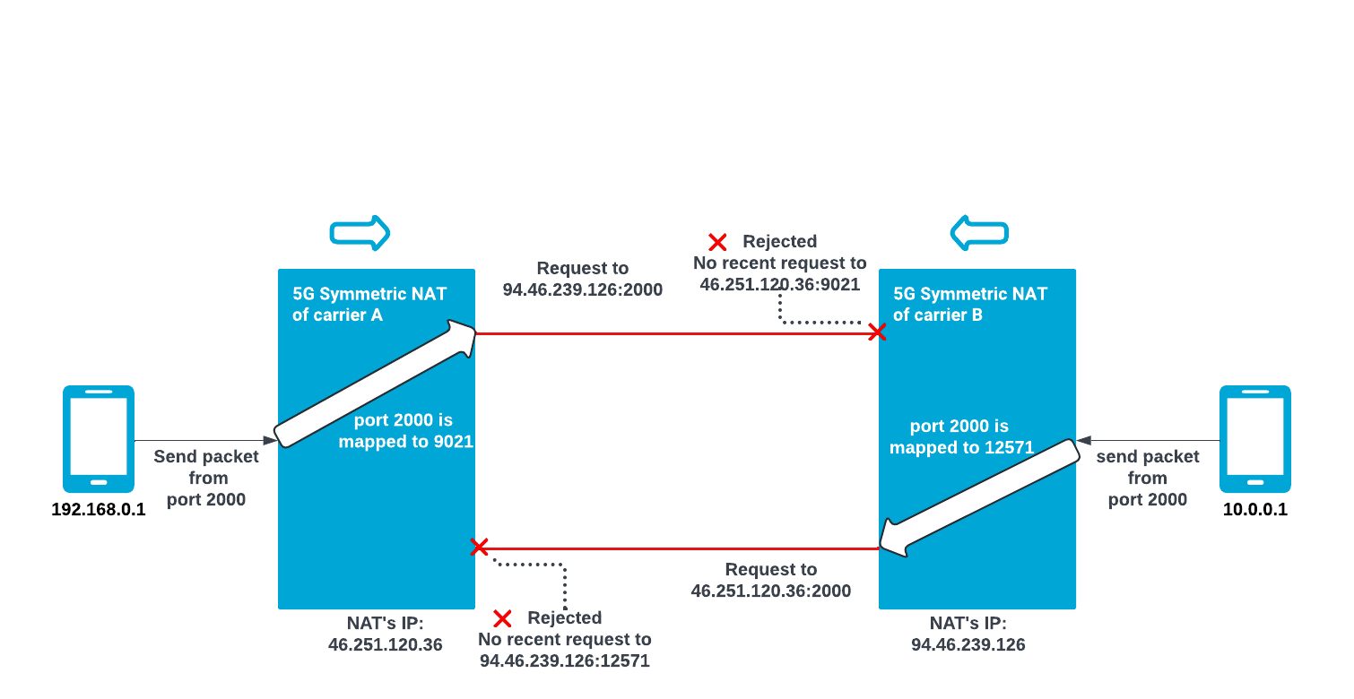
Communication in a (Symmetric) NATed Network
Notes:
Think of 2 peers on private IPs, both behind Symmetric NATs ,
to make the scenario more obvious the peers pre agreed to both use the same port, say 2000.
In the pre-NAT era just sending a packet to the communicated IP address and port would suffice.
NATs on their own make finding the peer’s IP address a hustle on its own, but we skipped that part and assumed that the peers already know each other’s NAT’s public IP address which is a delicate and cumbersome process on its own.
One thing they have absolutely no way of communicating is the port that the NAT will choose to open.
As you see in this scenario the NATs choose to map to completely different ports numbers even though both peers opened the same port (2000).
So what happens when peer A sends a packet to peer B’s port 2000 on the NAT’s IP address?
Packet gets dropped and disappears.
Peer A can only differ that the packet was dropped by the lack of response that they assume will arrive from peer B and vice versa.

Slide 19
NAT Puncturing

Slide 20
NAT Puncturing
How does it work:
⇒ Both peers (in some time window) need to guess and attempt to send a packet to the port that the other’s NAT opened

Slide 21
Note
Symmetric NATs creates a new mapping for each new destination IP-port pair

Slide 22
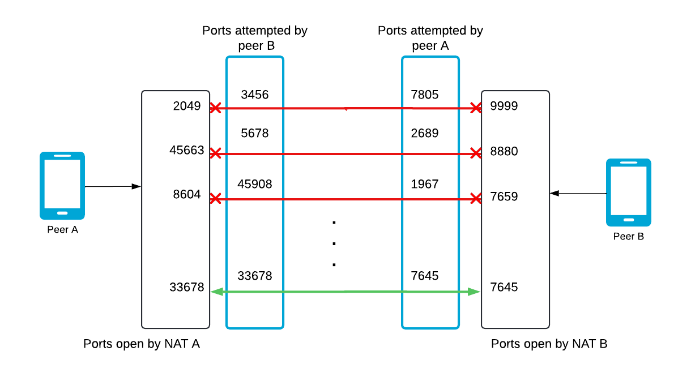
NAT Puncturing
Notes:
To ease the explanation of how NAT puncturing works think of an instant time-window and the NATs have a memory of one mapping.
If we assume that peers have some way of synchronizing to send the packets at the same time then each peer needs to guess what port their fellow peer mapped to. This thing needs to happen simultaneously.
In reality mappings that have not been “confirmed” have a time to live. the most common duration from the analysis was 120 seconds. Now one would assume that since you can send a lot of requests very fast and based on the combinatorics then the probability of collision is not that bad and it won’t take outrageous amount of time to try all of the combinations (multiple times each).
But a factor outside of our control is that NATs have limited memory which is among others consumed by other users using that cellular providers antena.
This makes quantifying the time needed to puncture a NAT or the difficulty not an exact science since it is very much depended on the time of the day, and the amount of users and the usage that occurs on that specific antena on that specific instant.

Slide 23
NAT Puncturing
How does it work:
⇒ Both peers (in some time window) need to guess and attempt to send a packet to the port that the other’s NAT opened
Problem:
Both peers in a certain time window need to guess each others port number say a,b
a,b ∈ [0, 65535]
Worst case scenario probability is 1 / (65535)^2

Slide 24
NAT Puncturing
Goal:
⇒ Both peers (in some time window) need to guess and attempt to send a packet to the port that the other’s NAT opened
Problem:
Both peers in a certain time window need to guess each others port number say a,b
a,b ∈ [0, 65535]
Worst case scenario probability is 1 / (65535)^2
NATs have limited memory ⇒ time window decreases

Slide 25
NAT Puncturing
Goal:
⇒ Both peers (in some time window) need to guess and attempt to send a packet to the port that the other’s NAT opened
Problem:
Both peers in a certain time window need to guess each others port number say a,b
a,b ∈ [0, 65535]
Worst case scenario probability is 1 / (65535)^2
NATs have limited memory ⇒ time window decreases
Can be impacted by latency and delays

Slide 26
NAT Puncturing
Goal:
⇒ Both peers (in some time window) need to guess and attempt to send a packet to the port that the other’s NAT opened
Problem:
Both peers in a certain time window need to guess each others port number say a,b
a,b ∈ [0, 65535]
Worst case scenario probability is 1 / (65535)^2
NATs have limited memory ⇒ time window decreases
Can be impacted by latency and delays
⇒ Can be improved using the Birthday-Paradox but still not good enough
Notes:
The Birthday Paradox is a famous problem in probability theory that demonstrates how counterintuitive probabilities can be. It refers to the surprisingly high likelihood that in a group of just 23 people, at least two of them will share the same birthday. While there are 365 possible birthdays, the probability of a shared birthday rises quickly as the group size increases. With only 23 people, the chance is already over 50%, and with 70 people, it's nearly 99.9%. The paradox lies in how the probability grows due to the many possible pairings between individuals, making the chances of a match much higher than most people would intuitively expect.

Slide 27
NAT Puncturing Attempt
An attempt is comprised of
at most 243587* connection initiation packets
sequentially transmitted at minimum possible interval
* 243587 is the birthday-paradox based 99.9% probability

Slide 28
NAT Puncturing Attempt
An attempt is comprised of
at most 243587* connection initiation packets
sequentially transmitted at minimum possible interval
An attempt ends
as soon as a response is received
or
no response is received 60 seconds after sending the last packet
* 243587 is the birthday-paradox based 99.9% probability

Slide 29
Improving the NAT Puncturing Success Rate

Slide 30
Improving the NAT Puncturing Success Rate
Birthday-attack NAT puncturing results were underwhelming:

Slide 31
Improving the NAT Puncturing Success Rate
Birthday-attack NAT puncturing results were underwhelming:
Best combination yielded a 4 out of 10 success rate

Slide 32
Improving the NAT Puncturing Success Rate
Birthday-attack NAT puncturing results were underwhelming:
Best combination yielded a 4 out of 10 success rate
Few achieved to connect once

Slide 33
Improving the NAT Puncturing Success Rate
Birthday-attack NAT puncturing results were underwhelming:
Best combination yielded a 4 out of 10 success rate
Few achieved to connect once
Most failed

Slide 34
Improving the NAT Puncturing Success Rate
Improvement Idea

Slide 35
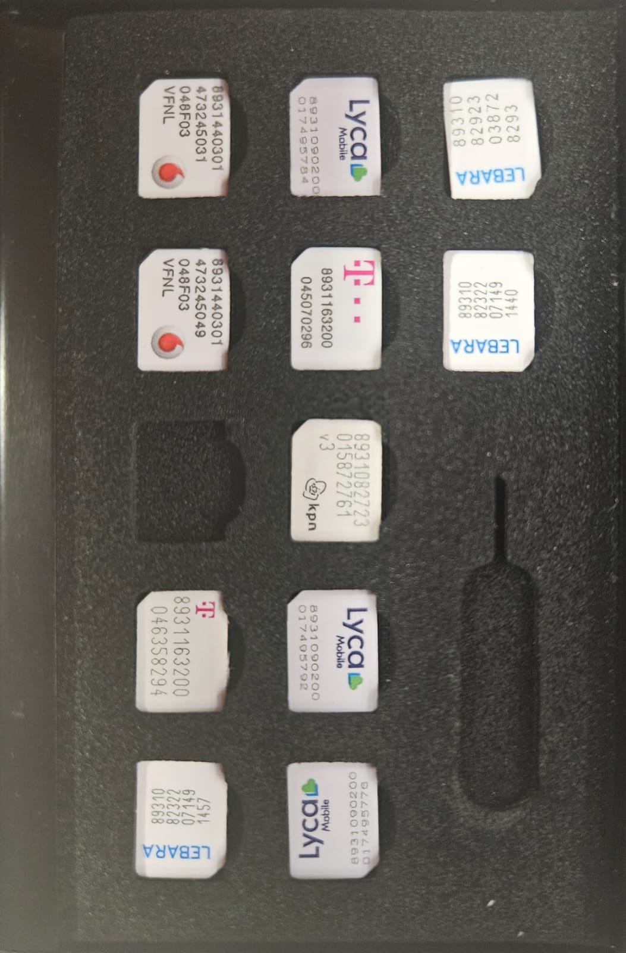
Improving the NAT Puncturing Success Rate
Get some SIM cards

Slide 36
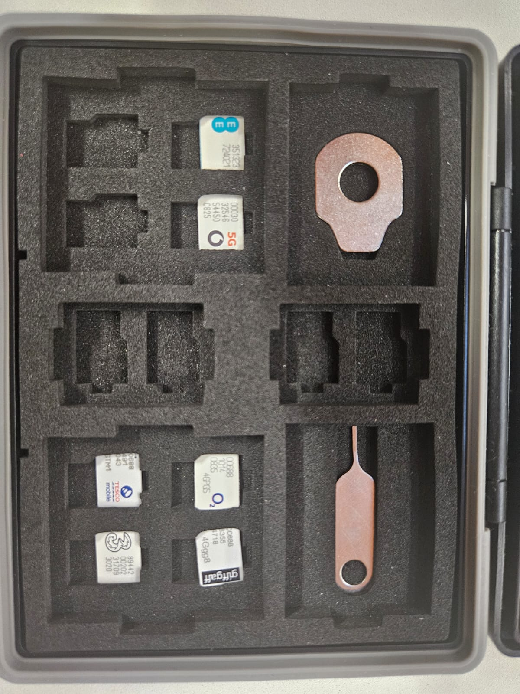
Improving the NAT Puncturing Success Rate
And some more…

Slide 37
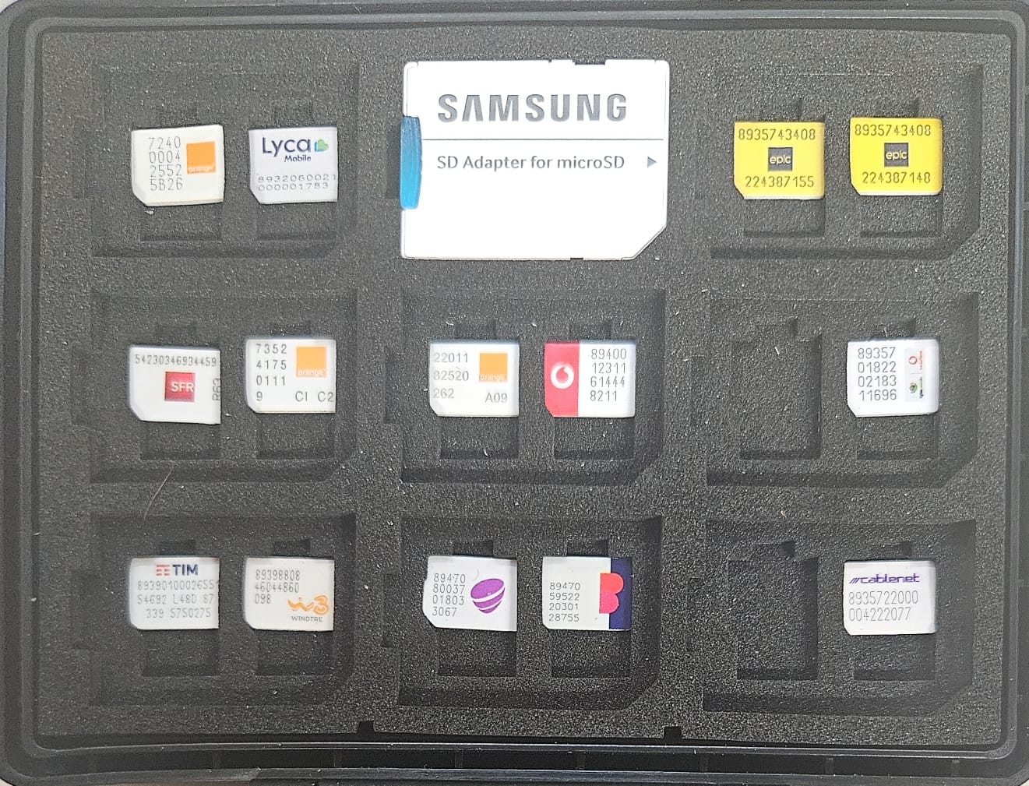
Improving the NAT Puncturing Success Rate
Procured 31 SIMs
From 8 countries!
*There used to be 34 but I threw away 3 in a rage

Slide 38
Improving the NAT Puncturing Success Rate
Idea:
Gather data on the NAT mapping

Slide 39
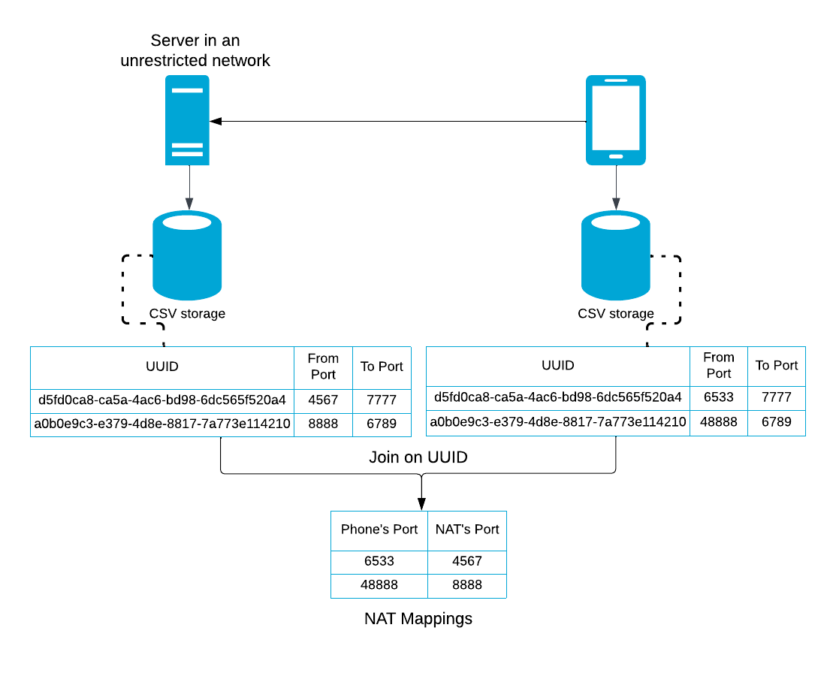
Data Gathering Setup

Slide 40
Improving the NAT Puncturing Success Rate
Idea:
Gather data on the NAT mapping
Reverse engineer the NAT

Slide 41
Improving the NAT Puncturing Success Rate
Idea:
Gather data on the NAT mapping
Attempt to reverse engineer the NAT
Use the NAT’s algorithm to improve the success rate

Slide 42
Data Analysis Results

Slide 43
Data Analysis Results

Slide 44
Data Analysis Results
….

Slide 45
Timeouts

Slide 46
Timeouts
2 timeout types are considered.

Slide 47
Timeouts
2 Timeout types
Connection Initiation ⇒ How long the NAT mapping will remain when no initial response is received

Slide 48
Timeouts
2 Timeout types
Connection Initiation ⇒ How long the NAT mapping will remain when no initial response is received
Idleness ⇒ How long the NAT mapping will remain if communication suddenly paused

Slide 49
Timeouts
Connection Initiation :Gives an estimate of the time needed to connect

Slide 50
Timeouts
Idleness: Connecting is “expensive”. How often to send packets to maintain the connection

Slide 51
Timeouts
Connection Initiation :Gives an estimate of the time needed to connect
Idleness: Connecting is “expensive”. How often to send packets to maintain the connection
Process:
Phone and server exchange packets with an ever increasing delay.

Slide 52
Timeouts
Connection Initiation :Gives an estimate of the time needed to connect
Idleness: Connecting is “expensive”. How often to send packets to maintain the connection
Process:
Phone and server exchange packets with an ever increasing delay.
For connection initiation the server waits

Slide 53
Timeouts
Connection Initiation :Gives an estimate of the time needed to connect
Idleness: Connecting is “expensive”. How often to send packets to maintain the connection
Process:
Phone and server exchange packets with an ever increasing delay.
For connection initiation the server waits
For Idleness the phone waits

Slide 54
NAT Puncturing Library

Slide 55
NAT Puncturing Library
Inputs:
User’s Cellular Carrier Name

Slide 56
NAT Puncturing Library
Inputs:
User’s Cellular Carrier Name
Peer’s IPv4 address

Slide 57
NAT Puncturing Library
Inputs:
User’s Cellular Carrier Name
Peer’s IPv4 address
Peer’s Cellular Carrier Name

Slide 58
NAT Puncturing Library
How does it work ?

Slide 59
NAT Puncturing Library
Inputs:
User’s Cellular Carrier Name
Peer’s IPv4 address
Peer’s Cellular Carrier Name
Process:
Open ≅ 500 sockets

Slide 60
NAT Puncturing Library
Inputs:
User’s Cellular Carrier Name
Peer’s IPv4 address
Peer’s Cellular Carrier Name
Process:
Open ≅ 500 sockets
A percentage of time, chooses a port based on peer’s NAT algorithm

Slide 61
NAT Puncturing Library
Inputs:
User’s Cellular Carrier Name
Peer’s IPv4 address
Peer’s Cellular Carrier Name
Process:
Open ≅ 500 sockets
A percentage of time, chooses a port based on peer’s NAT algorithm
Random ports the rest of the time

Slide 62
NAT Puncturing Library
Inputs:
User’s Cellular Carrier Name
Peer’s IPv4 address
Peer’s Cellular Carrier Name
Process:
Open ≅ 500 sockets
Predict ports based on peer’s NAT algorithm some time
Random ports rest of the time
Return:
⇒ Peer’s port number and the socket where the connection is occured from

Slide 63
Reminder before results!!!
An attempt is comprised of
at most 243587* connection initiation packets
sequentially transmitted at minimum possible interval
An attempt ends
as soon as a response is received
or
no response is received 60 seconds after sending the last packet
* 243587 is the birthday-paradox based 99.9% probability

Slide 64
Random vs cellular provider aware NAT Puncturing

Slide 65
Random vs cellular provider aware NAT Puncturing
Some Statistically Significant Improvements:

Slide 66
Random vs cellular provider aware NAT Puncturing
Some Statistically Significant Improvements:
Cyta - Cyta (Cyprus): Success Rate: 10% ⇒ 90%

Slide 67
Random vs cellular provider aware NAT Puncturing
Some Statistically Significant Improvements:
Cyta - Cyta (Cyprus): Success Rate: 10% ⇒ 90%
Lebara - Odido (Netherlands): Success Rate: 0% ⇒ 60%

Slide 68
Random vs cellular provider aware NAT Puncturing
Some Statistically Significant Improvements:
Cyta - Cyta (Cyprus): Success Rate: 10% ⇒ 90%
Lebara - Odido (Netherlands): Success Rate: 0% ⇒ 60%
Lebara - VodaFone (Netherlands): Success Rate: 10% ⇒ 60%

Slide 69
Random vs cellular provider aware NAT Puncturing
Some Statistically Significant Improvements:
Cyta - Cyta (Cyprus): Success Rate: 10% ⇒ 90%
Lebara - Odido (Netherlands): Success Rate: 0% ⇒ 60%
Lebara - VodaFone (Netherlands): Success Rate: 10% ⇒ 60%
General Improvements

Slide 70
Random vs cellular provider aware NAT Puncturing
Some Statistically Significant Improvements:
Cyta - Cyta (Cyprus): Success Rate: 10% ⇒ 90%
Lebara - Odido (Netherlands): Success Rate: 0% ⇒ 60%
Lebara - VodaFone (Netherlands): Success Rate: 10% ⇒ 60%
General Improvements
Pairs that connected successfully
Netherlands: 5/15 ⇒ 8/15 60% ⇑

Slide 71
Random vs cellular provider aware NAT Puncturing
Some Statistically Significant Improvements:
Cyta - Cyta (Cyprus): Success Rate: 10% ⇒ 90%
Lebara - Odido (Netherlands): Success Rate: 0% ⇒ 60%
Lebara - VodaFone (Netherlands): Success Rate: 10% ⇒ 60%
General Improvements
Pairs that connected successfully
Netherlands: 5/15 ⇒ 8/15 60% ⇑
Cyprus: 1/10 ⇒ 4/10 300% ⇑

Slide 72
Random vs cellular provider aware NAT Puncturing
Some Statistically Significant Improvements:
Cyta - Cyta (Cyprus): Success Rate: 10% ⇒ 90%
Lebara - Odido (Netherlands): Success Rate: 0% ⇒ 60%
Lebara - VodaFone (Netherlands): Success Rate: 10% ⇒ 60%
General Improvements
Pairs that connected successfully
Netherlands: 5/15 ⇒ 8/15 60% ⇑
Cyprus: 1/10 ⇒ 4/10 300% ⇑
Connectivity Success Ratio (Pairs)

Slide 73
Random vs cellular provider aware NAT Puncturing
Some Statistically Significant Improvements:
Cyta - Cyta (Cyprus): Success Rate: 10% ⇒ 90%
Lebara - Odido (Netherlands): Success Rate: 0% ⇒ 60%
Lebara - VodaFone (Netherlands): Success Rate: 10% ⇒ 60%
General Improvements
Pairs that connected successfully
Netherlands: 5/15 ⇒ 8/15 60% ⇑
Cyprus: 1/10 ⇒ 4/10 300% ⇑
Connectivity Success Ratio (Pairs)
Netherlands: 5 improved, 8 constant, 2 worsened

Slide 74
Random vs cellular provider aware NAT Puncturing
Some Statistically Significant Improvements:
Cyta - Cyta (Cyprus): Success Rate: 10% ⇒ 90%
Lebara - Odido (Netherlands): Success Rate: 0% ⇒ 60%
Lebara - VodaFone (Netherlands): Success Rate: 10% ⇒ 60%
General Improvements
Pairs that connected successfully
Netherlands: 5/15 ⇒ 8/15 60% ⇑
Cyprus: 1/10 ⇒ 4/10 300% ⇑
Connectivity Success Ratio (Pairs)
Netherlands: 5 improved, 8 constant, 2 worsened
Cyprus: 4 improved, 6 constant

Slide 75
DeToks

Slide 76
Questions?
Thank you for your attention
#betterTUgether

