Slide 1
Master Project at DFKI
Mapping Infrastructure with Patch based Land Use and Land Cover Classification using Deep Learning
Submitted by:
Sachin Sharma
M.Sc Intelligent Systems
Supervised by:
Patrick Helber
PhD Researcher
TU Kaiserslautern
1
Notes:
1

Slide 2
Content
Introduction
EuroSAT Dataset
Experiments
Results
Visualization of results
Future Scope
Real Life Application on OSM
TU Kaiserslautern
1

Slide 3
Introduction
This project is aimed at developing classification model which can be used for detecting land use or land cover classification.
Can help in improving geographical maps.
Near State of the art classifier is build
Classification and Probability Heatmaps were generated.
At the end every generated Classification Heatmap is visualized on Open Street Map.
TU Kaiserslautern
1

Slide 4
EuroSAT Dataset
Sentinel-2 satellite image dataset is used for experiments.
Settling down with the network which illustrates best performance.
This dataset in total has 27,000 geo-referenced images consisting of 10 classes.
Each image measures 64*64 pixels.
Each class contains 2000 to 3000 images.
10 different classes in dataset are Industrial, Residential, Annual Crop, Permanent Crop, River, Sea & Lake, Herbaceous Vegetation, Highway, Pasture and Forest.
TU Kaiserslautern
1

Slide 5
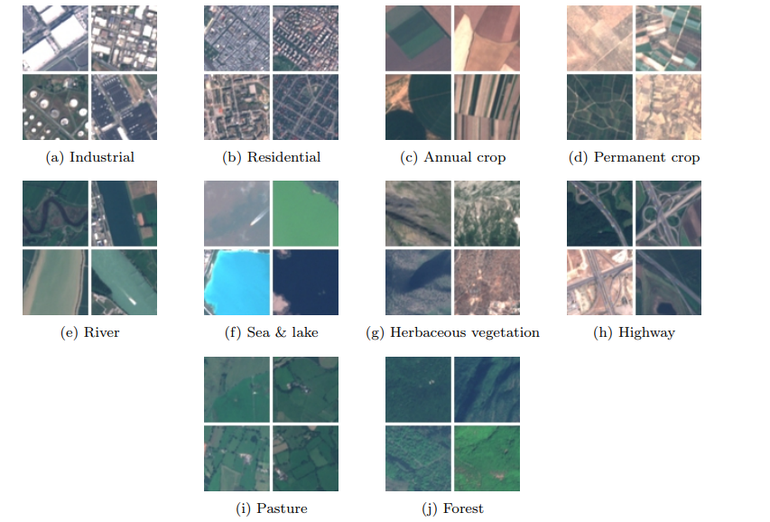
Overview of EuroSAT dataset
Fig: 1
Fig:1 reference: https://arxiv.org/pdf/1709.00029.pdf
1
TU Kaiserslautern

Slide 6
Experiments
Experiment 1: Considered Industrial and Residential as one class and rest of the 8 classes as it is.
To find out good accuracy for classifying satellite images following sub experiments were performed:
Classification on RGB EuroSAT images using shallow CNN architecture.
Fine Tuning of Resnet-50 architecture pretrained on imagenet weights(RGB images)
Fine Tuning of Resnet-50 architecture initialized with random weights(RGB images)
Classification on Multispectral Images(13 Band) using CNN.
TU Kaiserslautern
1

Slide 7
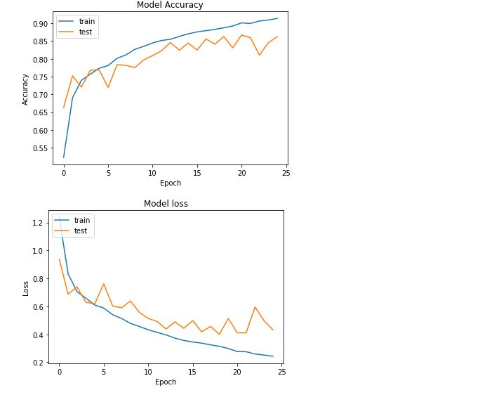
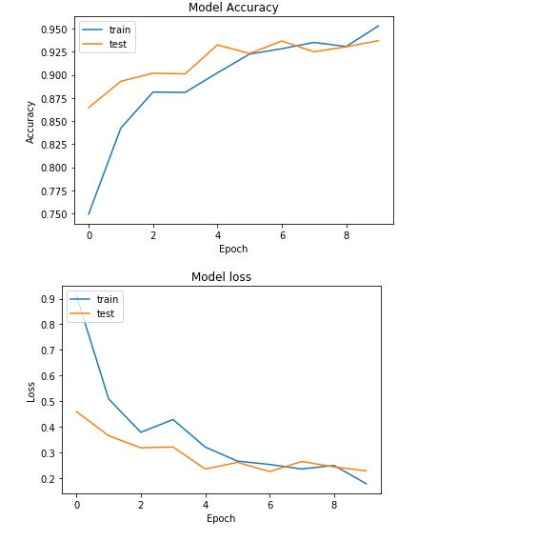
Results: a) Vs d)
MS CNN
Shallow CNN
1
TU Kaiserslautern

Slide 8
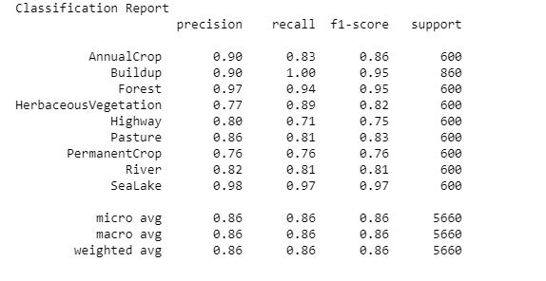
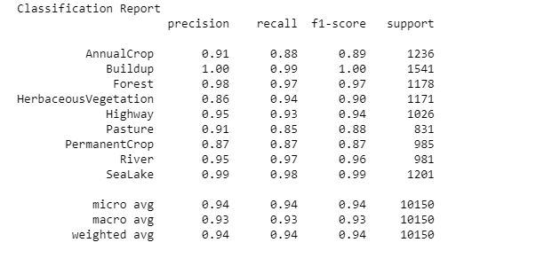
Classification Report comparison between experiment a)&d)
Shallow CNN
MS CNN
TU Kaiserslautern
1

Slide 9
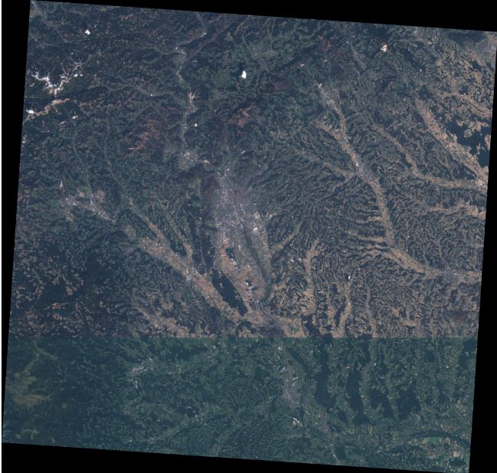
Classification Heatmap from experiment a) on Graz city
Shallow CNN
Graz Satellite image
TU Kaiserslautern
1
Notes:
1

Slide 10
Classification Heatmaps of experiment d) on Graz city
MS CNN
Graz Satellite image
TU Kaiserslautern
1
Notes:
1

Slide 11
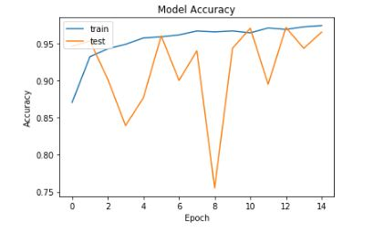
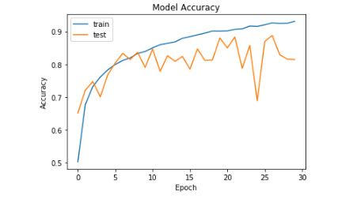
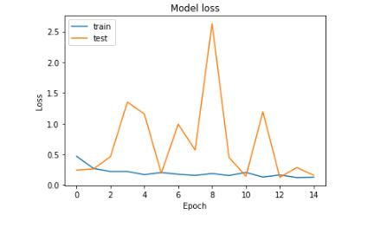
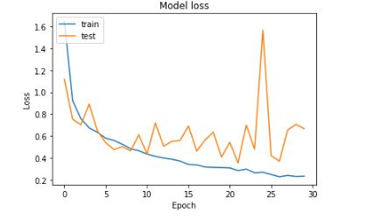
Results b) imgaenet weights VS c) randomly initialized weigths
TU Kaiserslautern
1
Notes:
1

Slide 12
Probability Heatmaps of Graz and Innsbruck city generated with experiment b) imagenet weights
Graz
TU Kaiserslautern
Innsbruck
1

Slide 13
Probability Heatmaps of Linz and Wien city generated with experiment b) imagenet weights
Linz
TU Kaiserslautern
Wien
1
Notes:
1

Slide 14
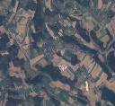
Classification Heatmap of Graz city generated with experiment b) imagenet weights
Permanent Crop
Graz Classification Heatmap
Graz Satellite image
TU Kaiserslautern
1

Slide 15
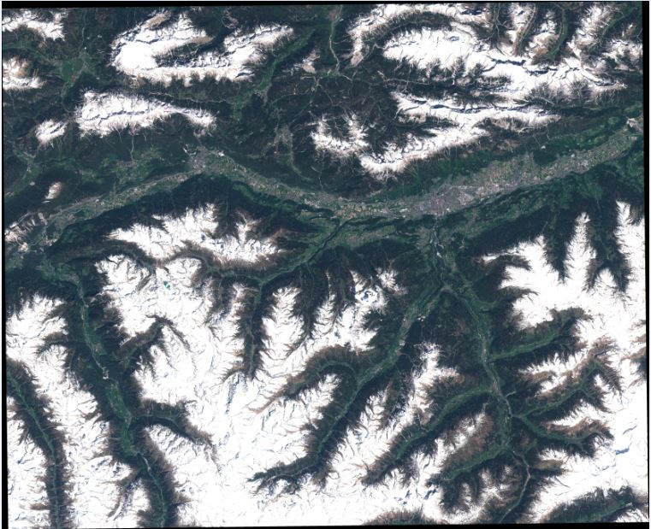
Classification Heatmap of Innsbruck city generated with experiment b) imagenet weights
Innsbruck Classification Heatmap
Innsbruck Satellite image
TU Kaiserslautern
1
Notes:
1

Slide 16
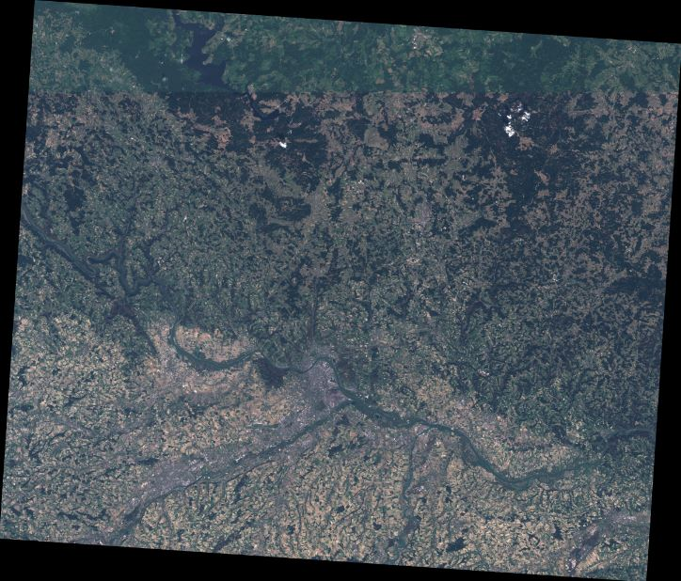
Classification Heatmaps of Linz city generated with experiment b) imagenet weights
Linz Classification Heatmap
Linz Satellite image
TU Kaiserslautern
1

Slide 17
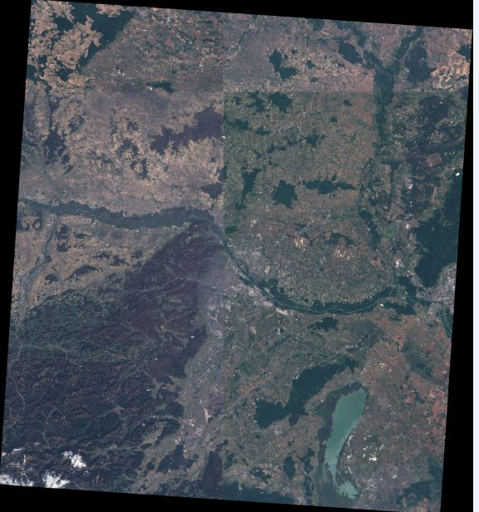
Classification Heatmaps of Wien city generated with experiment b) imagenet weights
Wien Classification Heatmap
Wien Satellite image
TU Kaiserslautern
1

Slide 18
Experiment 2: Considered Industrial and Residential as separate class and rest of the 8 classes as it is
To find out good accuracy or best results for classifying satellite images following sub experiments were performed:
Classification on RGB EuroSAT images using shallow CNN architecture.
Fine Tuning of Resnet-50 architecture pretrained on imagenet weights.
Fine Tuning of Resnet-50 architecture initialized with random weights.
Classification on Multispectral Images(13 Band) using CNN.
TU Kaiserslautern
1

Slide 19
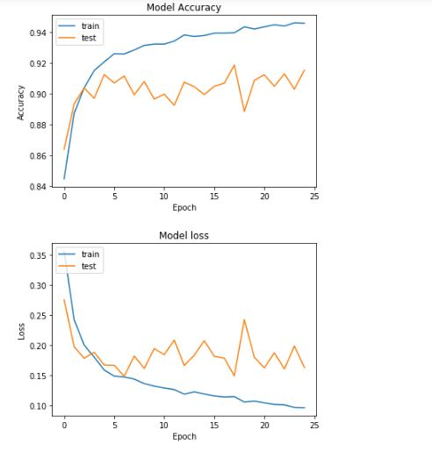
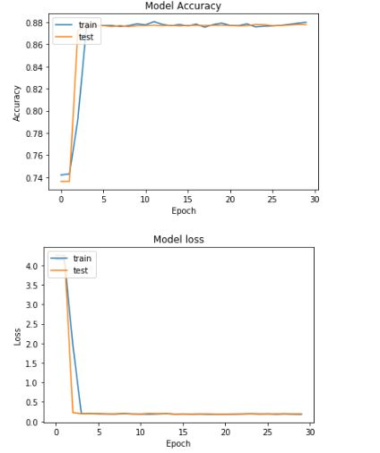
Results a) Shallow CNN Vs d) MS CNN:
TU Kaiserslautern
1

Slide 20
Confusion Matrix Comparison between experiment a), d) & b)
Shallow CNN
MS CNN
ImageNet Wts
TU kaiserslautern
1

Slide 21
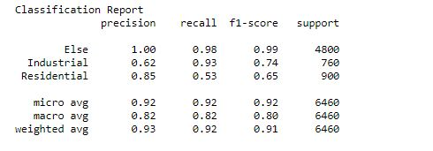
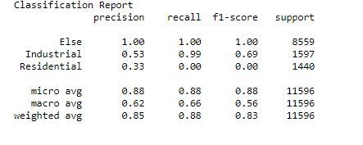
Classification report comparison between a)&d)
Shallow CNN
MS CNN
TU kaiserslautern
1

Slide 22
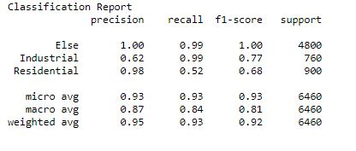
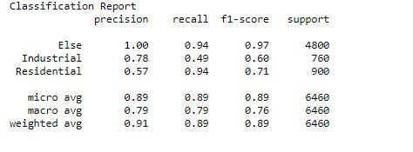
Results b)imageNet weights Vs c)randomly initialized weights
TU kaiserslautern
1

Slide 23
Classification Heatmaps of Graz city resulted from experiment b)imagenet weights
Graz Classification Heatmap
Graz Satellite image
1
TU Kaiserslautern
Notes:
<number>

Slide 24
Classification Heatmaps of Innsbruck city resulted from experiment b)imagenet weights
Innsbruck Classification Heatmap
TU Kaiserslautern
Innsbruck Satellite image
1

Slide 25
Classification Heatmaps of Linz city generated with experiment b) imagenet weights
Linz Classification Heatmap
TU Kaiserslautern
Linz Satellite image
1

Slide 26
Classification Heatmap of Wien city generated with experiment b) imagenet weights
Wien Classification Heatmap
Wien Satellite image
TU Kaiserslautern
1

Slide 27
Future Scope
Disaster Monitoring and Response
Zoning
Geographic Information System(GIS) update
Urban Mapping
TU kaiserslautern
1

Slide 28
Real Life application of project on OSM
Demo Application
TU Kaiserslautern
1

Slide 29
Thank You!
TU kaiserslautern
1
Notes:
<number>

