Slide 1
NeuroEducation without Borders
Mathew Birdsall Abrams, PhD, MPH
Deputy Director, INCF

Slide 2
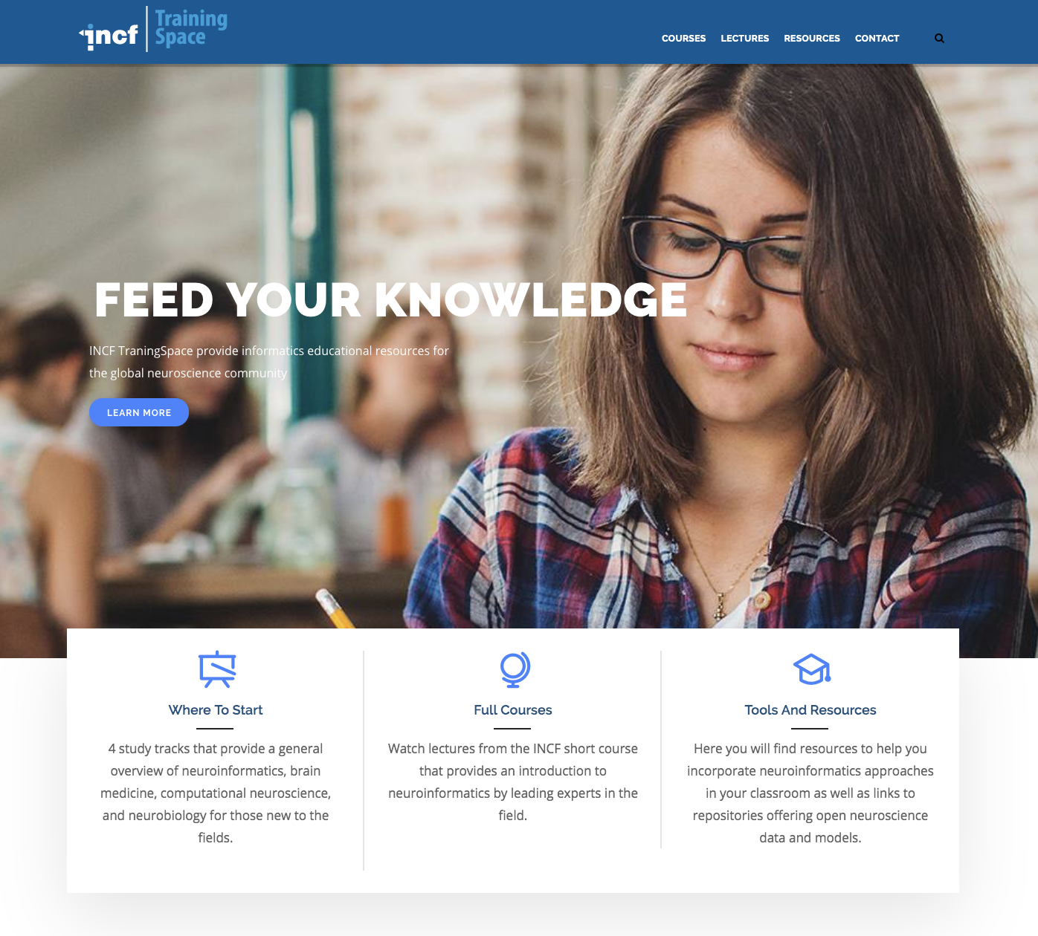
What is TrainingSpace?
TrainingSpace is an online hub that makes neuroscience educational materials more accessible to the global neuroscience community.
Provides users with access to:
Multimedia educational content from courses, conference lectures, and laboratory exercises
Study tracks to facilitate self-guided study
Tutorials on tools and open science resources for neuroscience research
A Q&A forum
A neuroscience encyclopedia/data discoverability portal that provides users with access to over 1.600.000 publicly available datasets as well as links to literature references and scientific abstracts

Slide 3




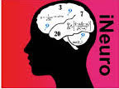






Content
Topics:
General neuroinformatics
Computational neuroscience
Computer science
Data science
Clinical neuroscience
General neuroscience
Curated Study Tracks:
Computational Neuroscience
Neuroinformatics
Neurobiology
Developed in partnership with:

Slide 4

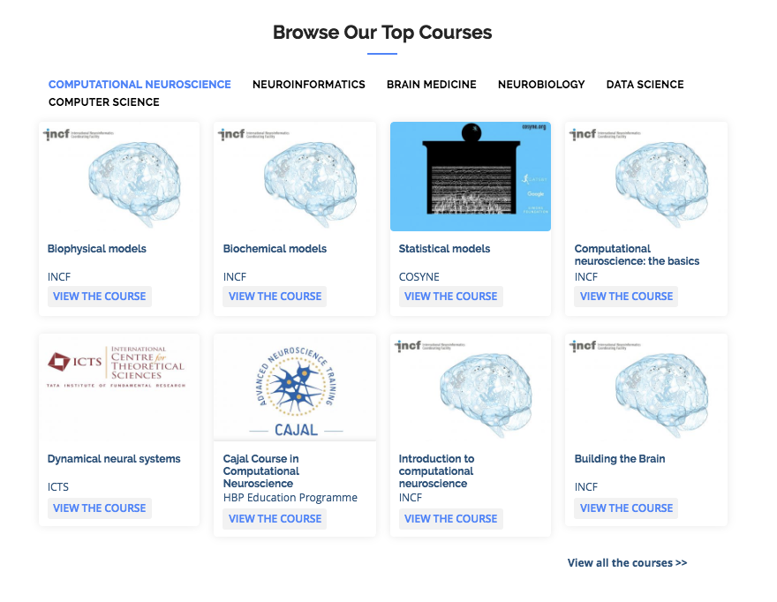
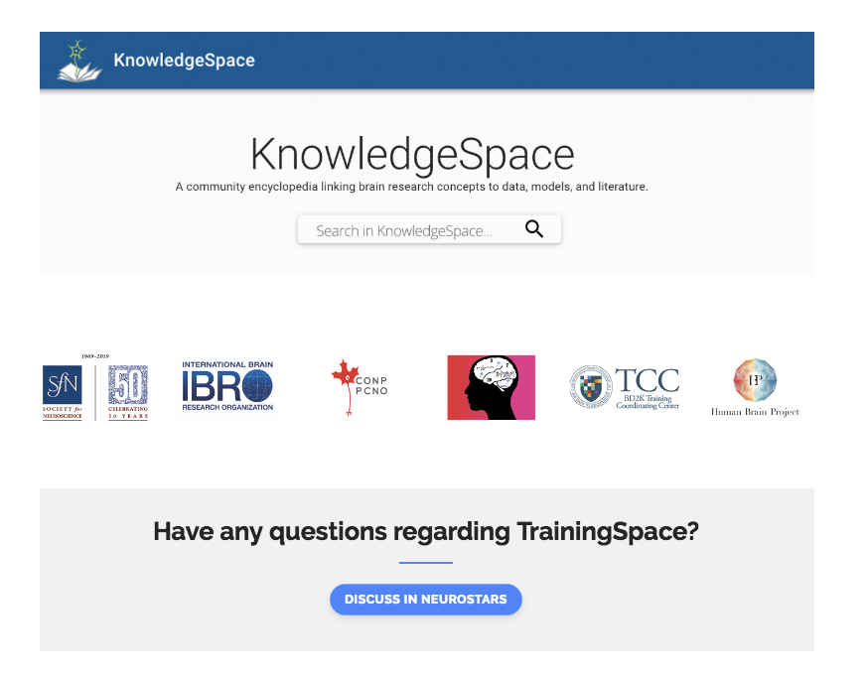
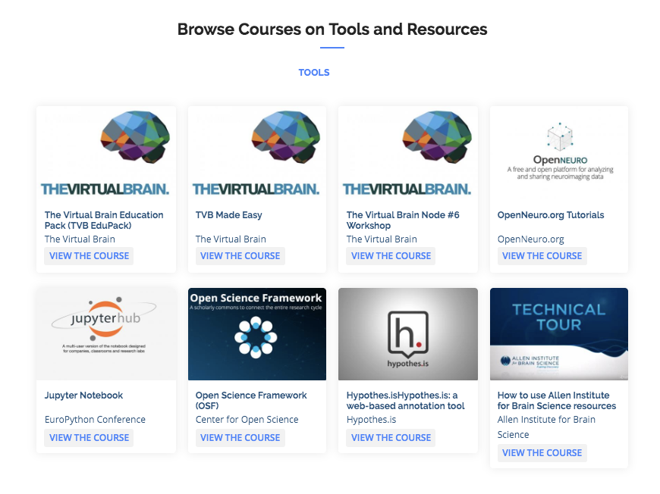

Slide 5
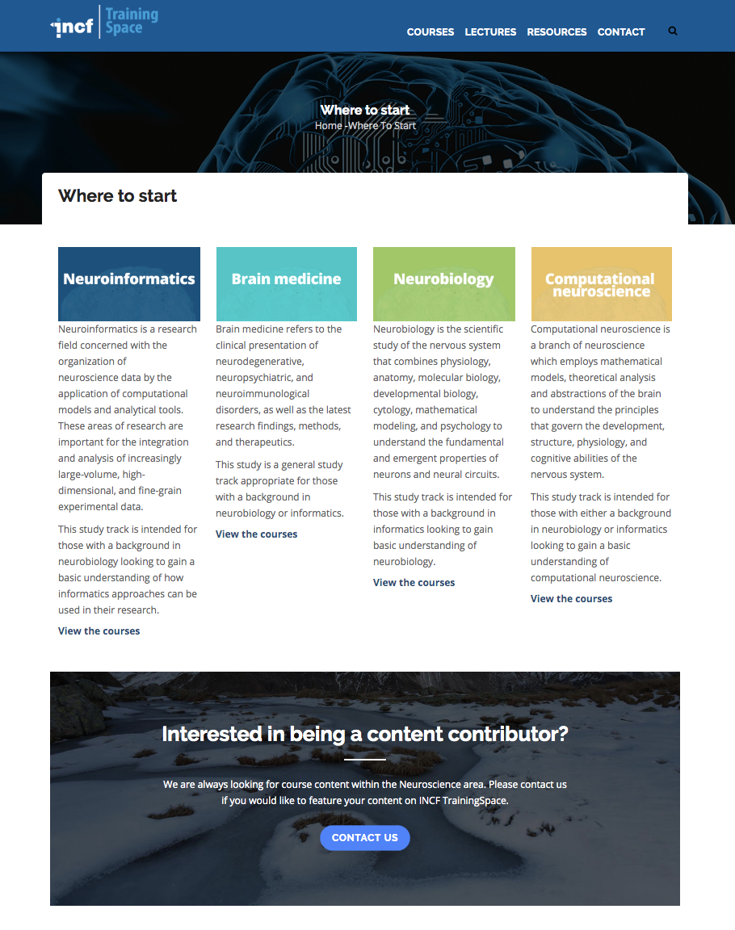
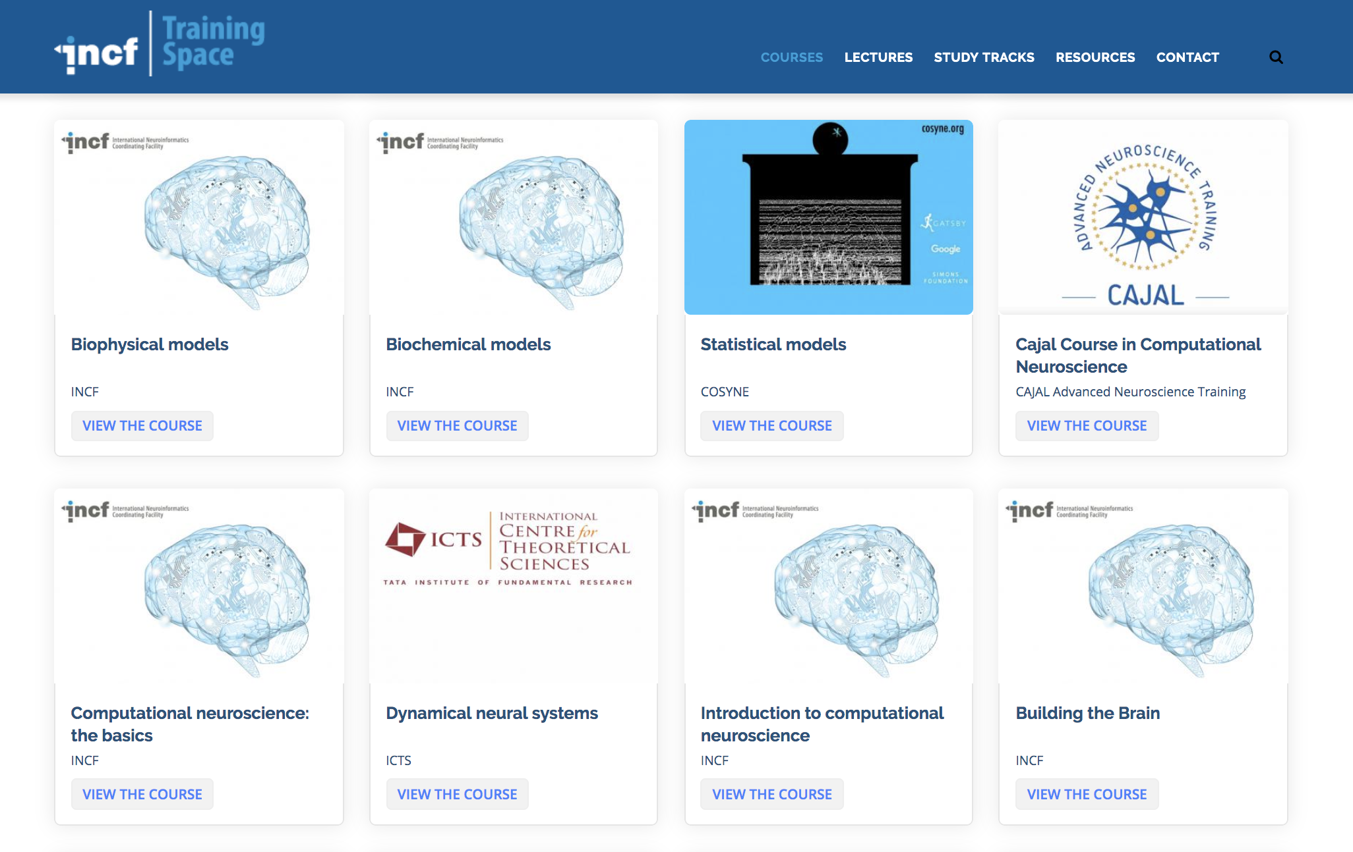
Study track

Slide 6
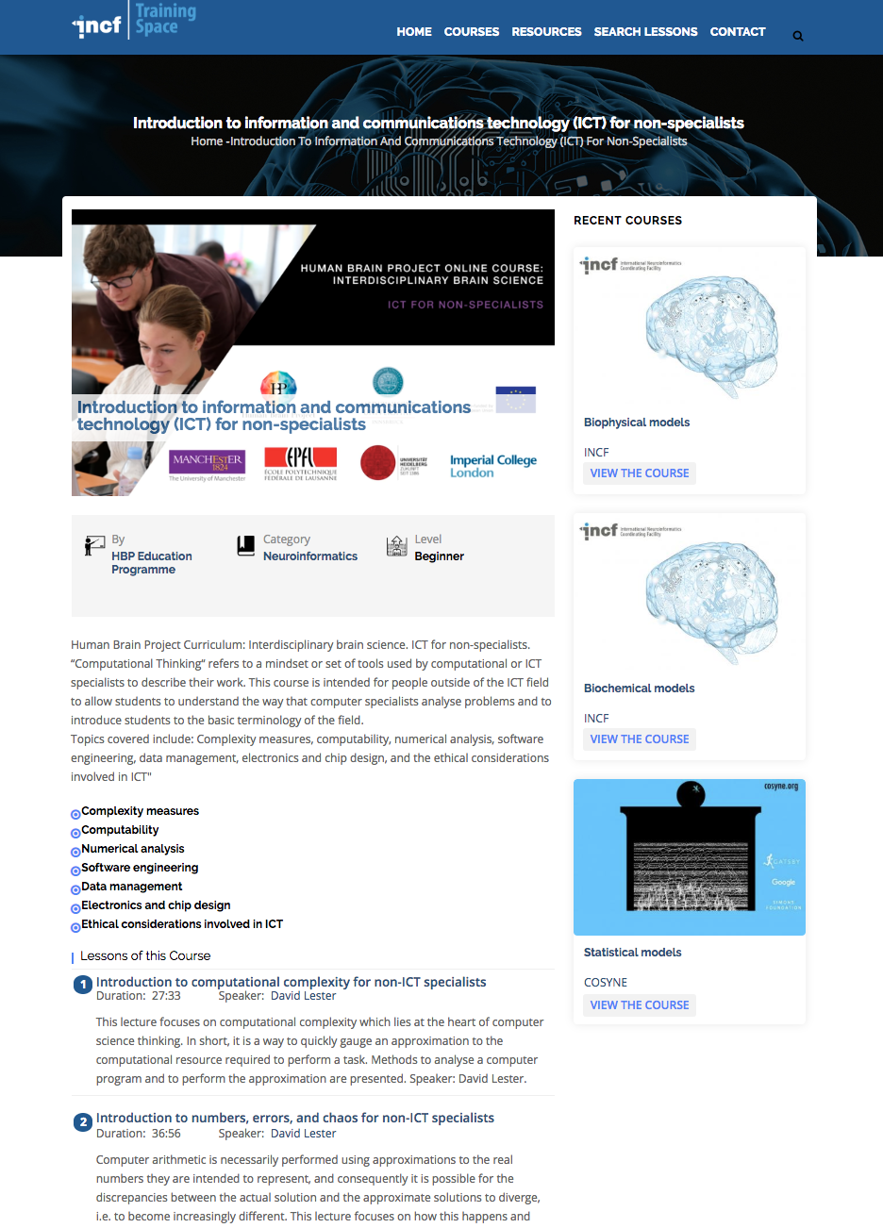
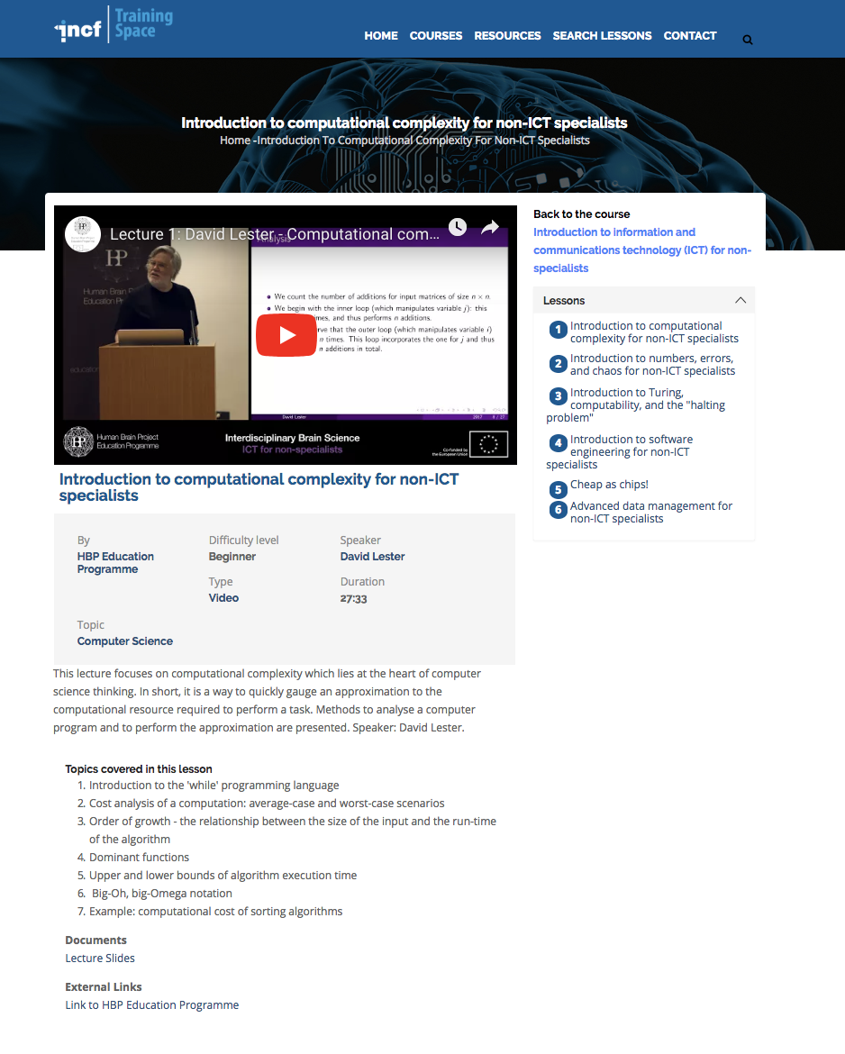
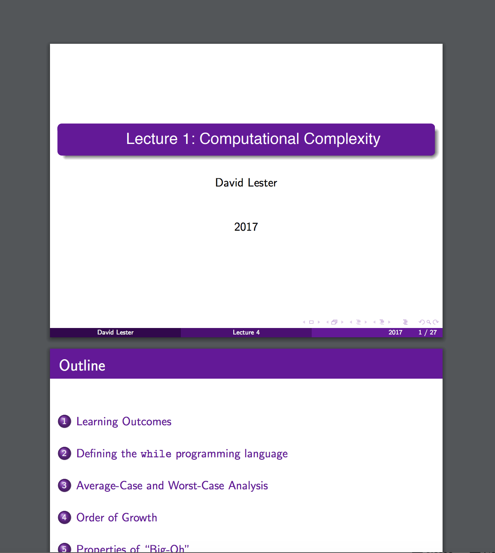
Courses

Slide 7
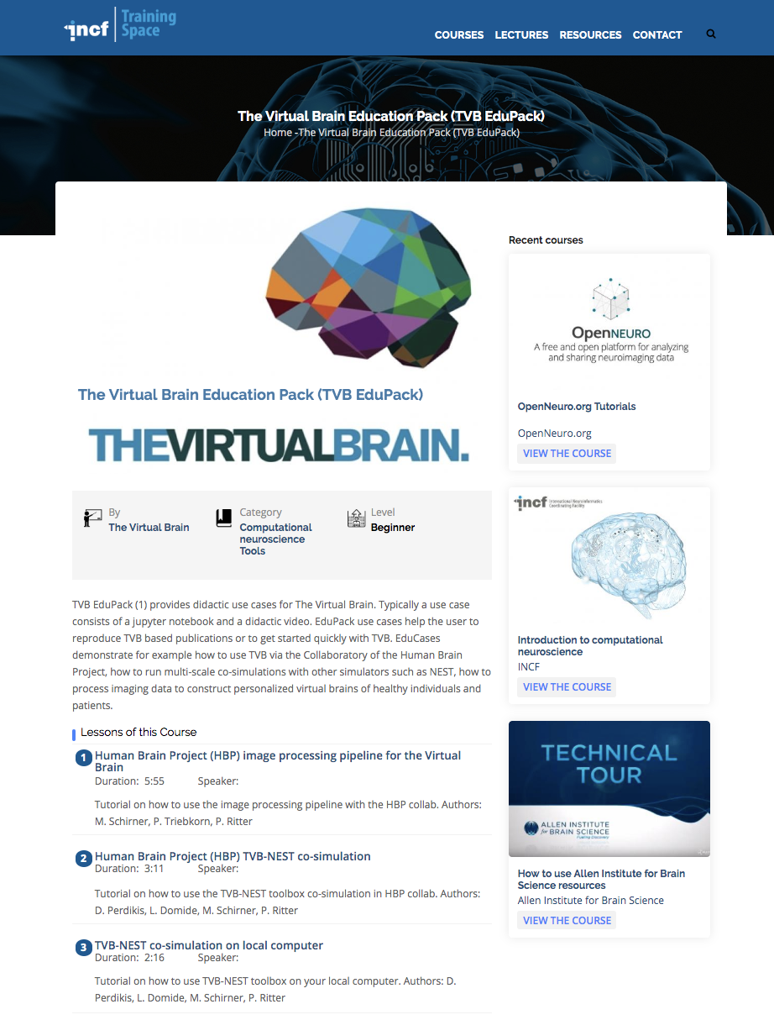
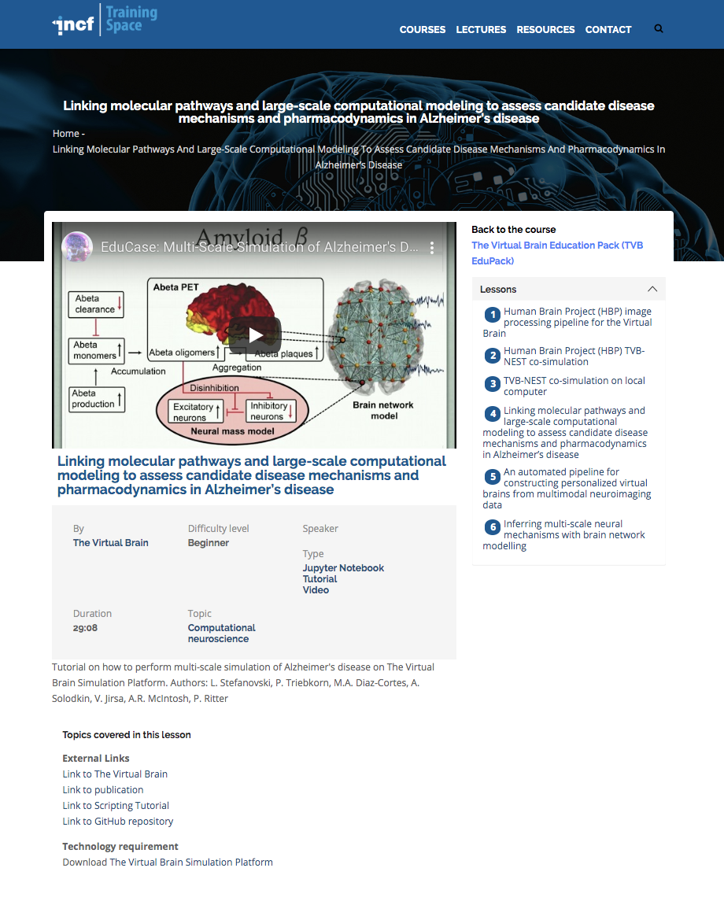
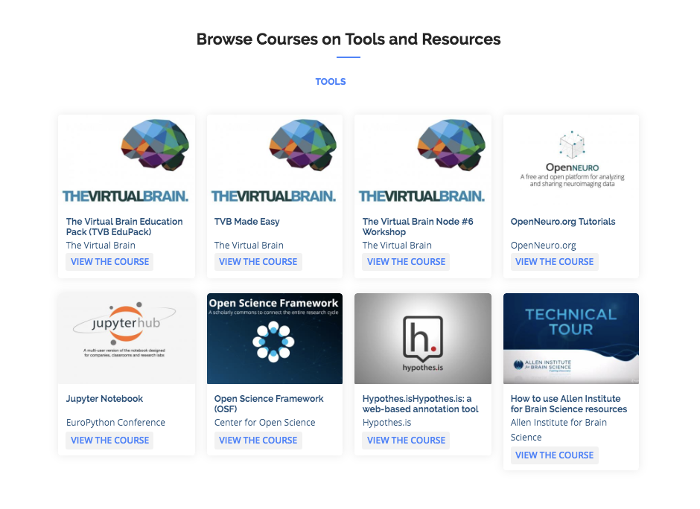
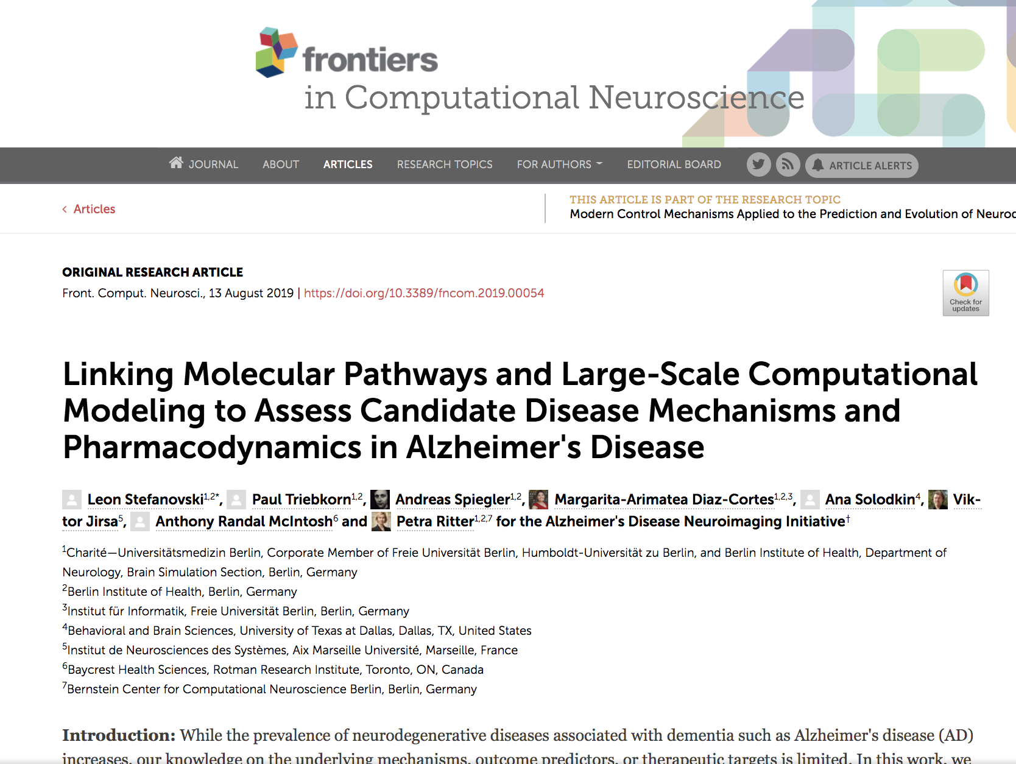
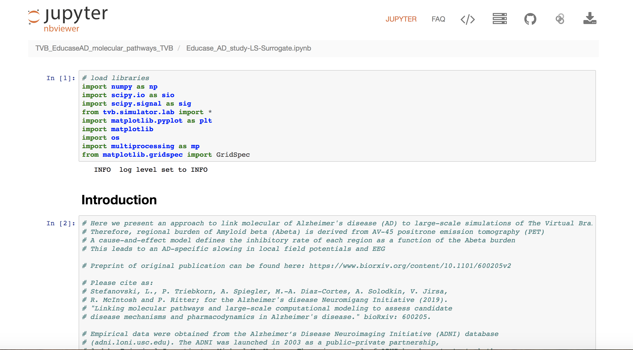
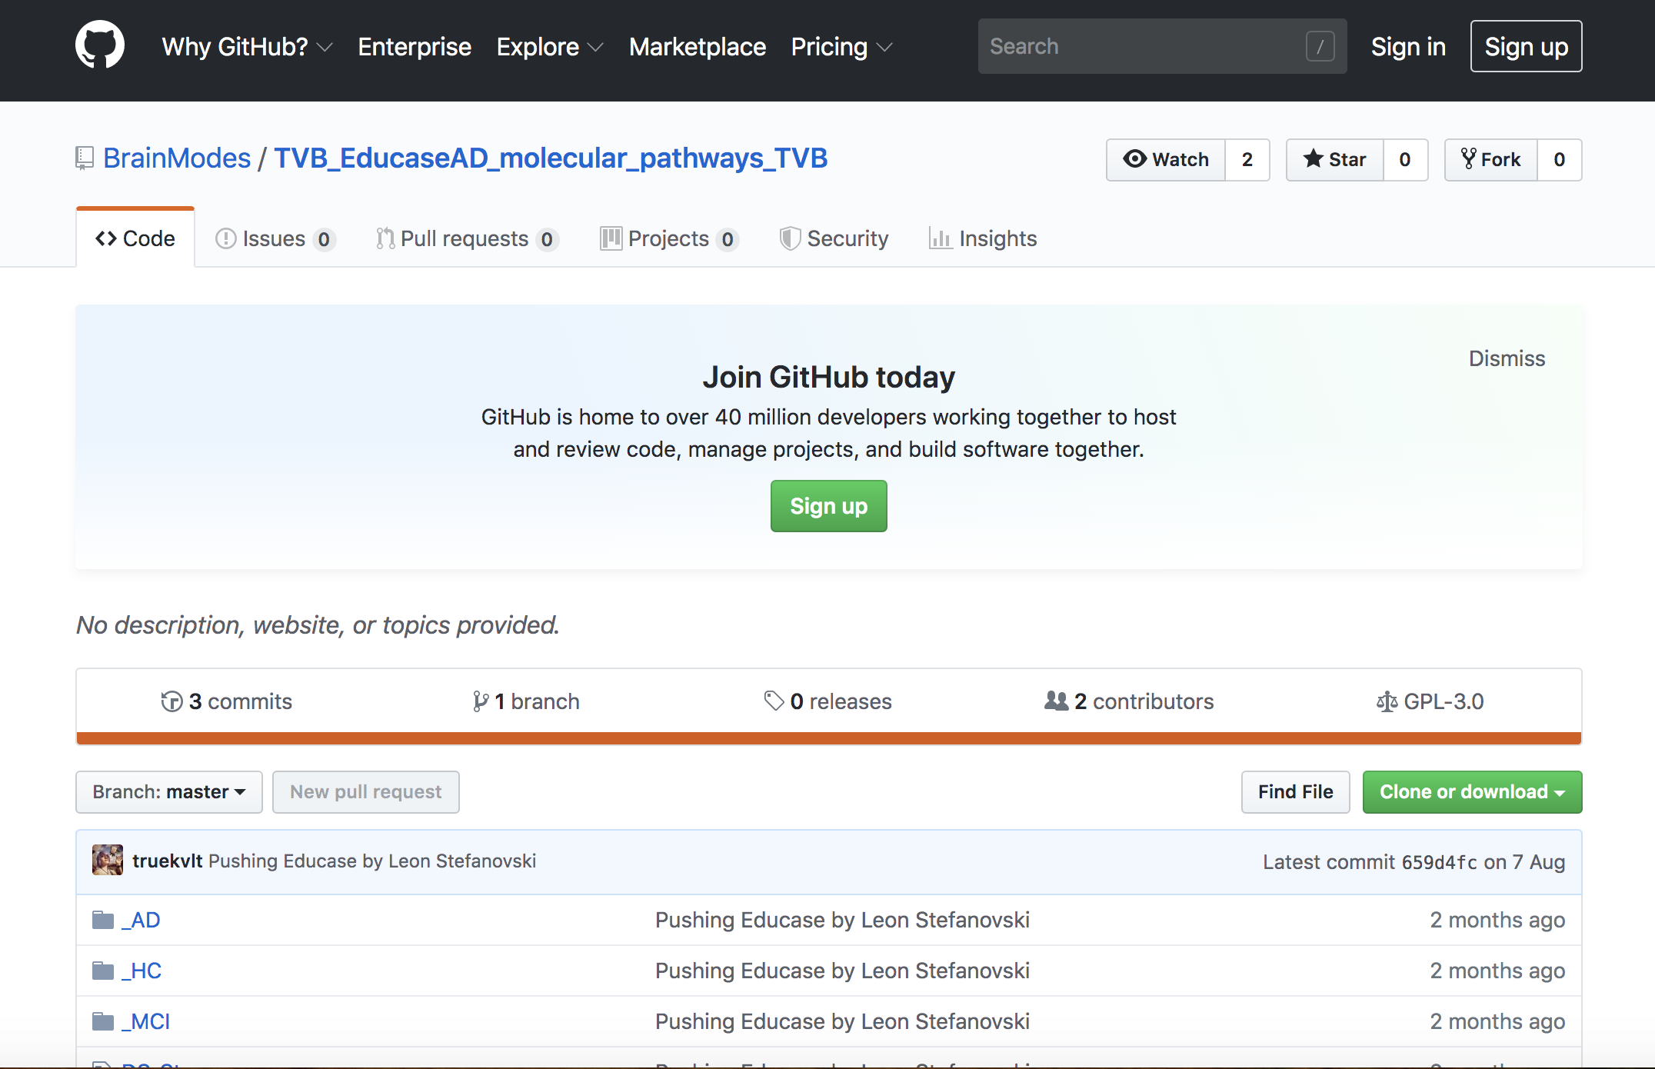
Tools

Slide 8
Neuroscience Encyclopedia and Open Data Portal
KnowledgeSpace
community-based encyclopedia for neuroscience that links brain research concepts to data, models, and the literature that support them developed by HBP, NIF, and INCF
a framework that combines the general descriptions of neuroscience concepts found in wikipedia with:
  More detailed content found in NeuroLex
  Integrates them with the latest neuroscience citations found in PubMed
  Data found in some of the world’s leading neuroscience repositories

Slide 9
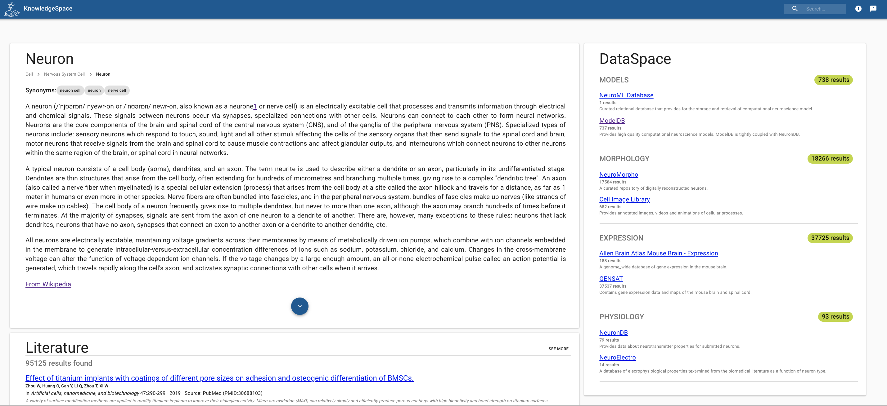
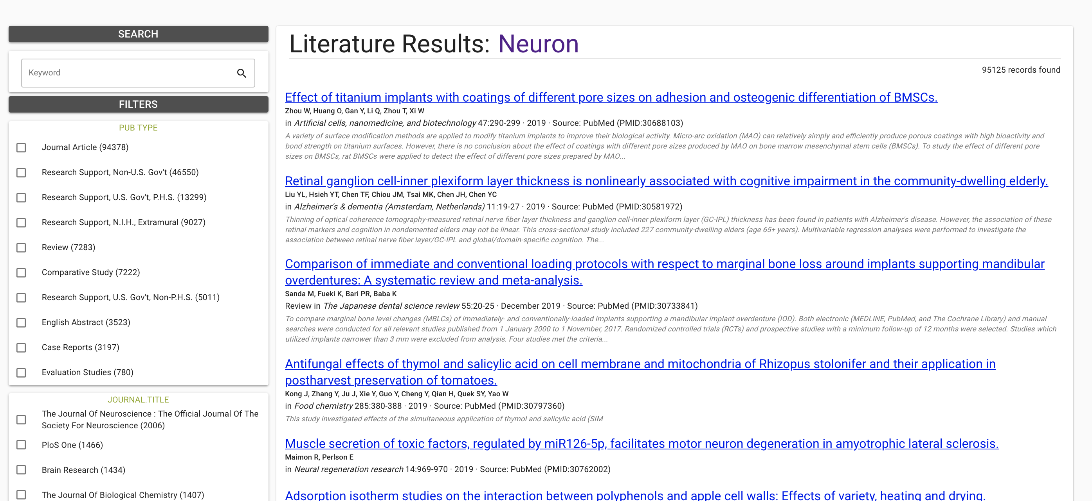

Slide 10
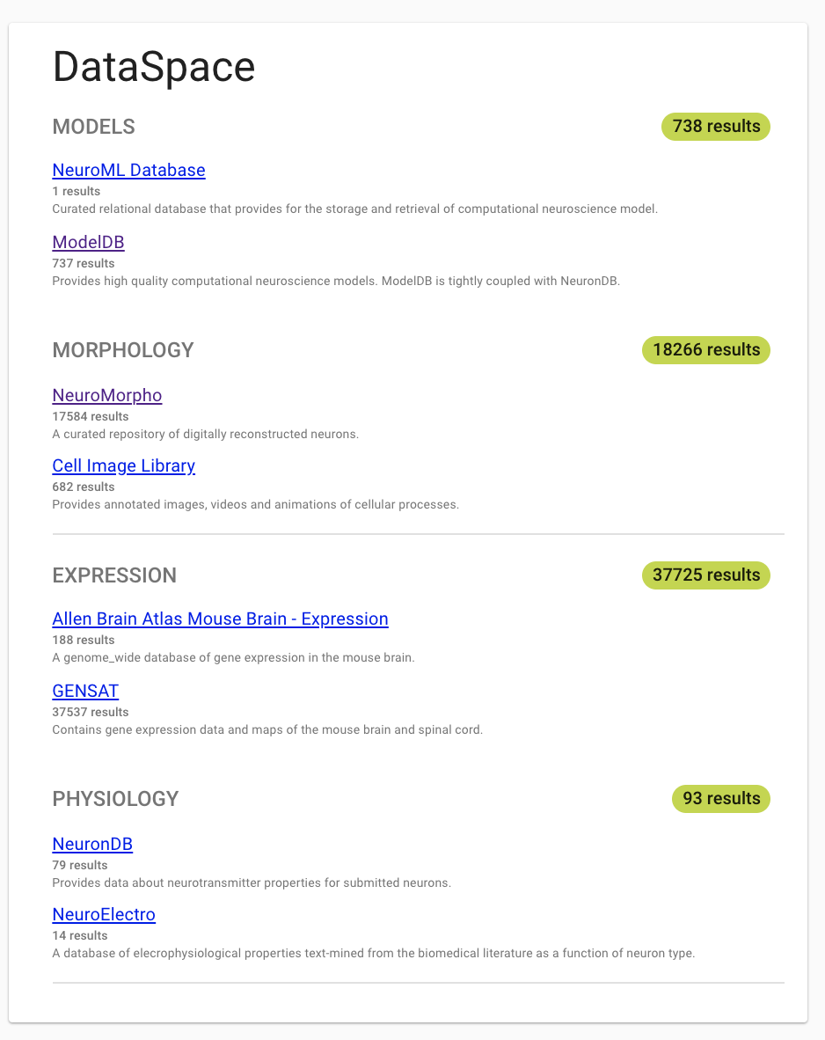
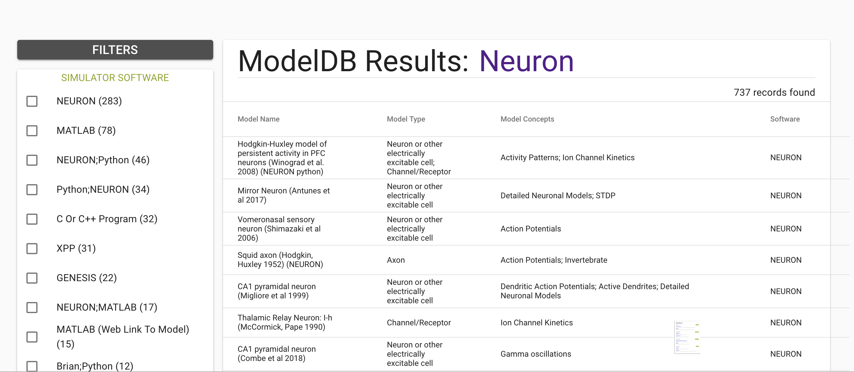
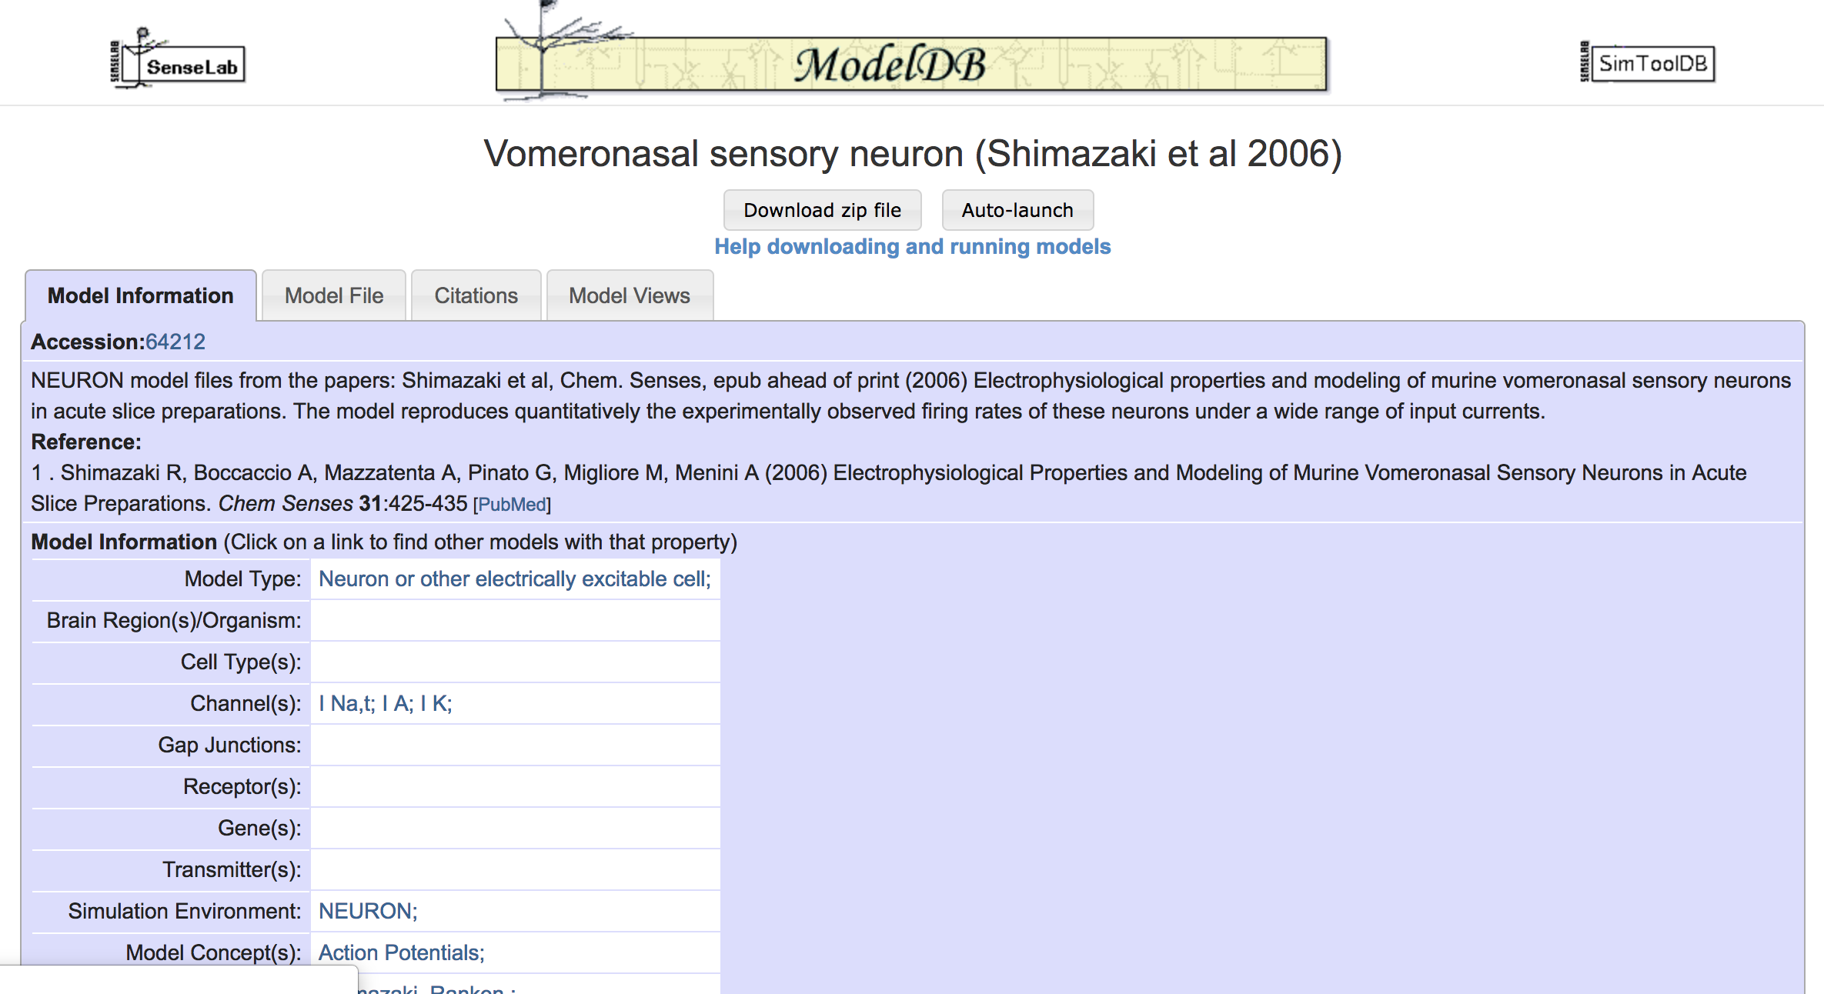

Slide 11
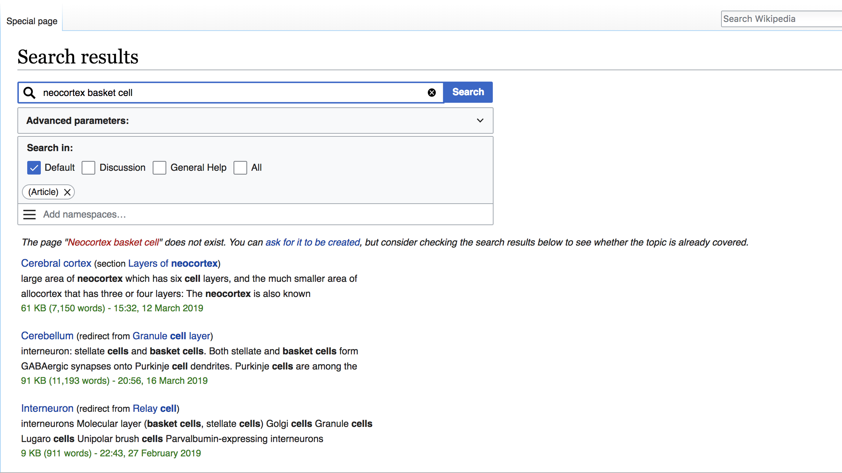
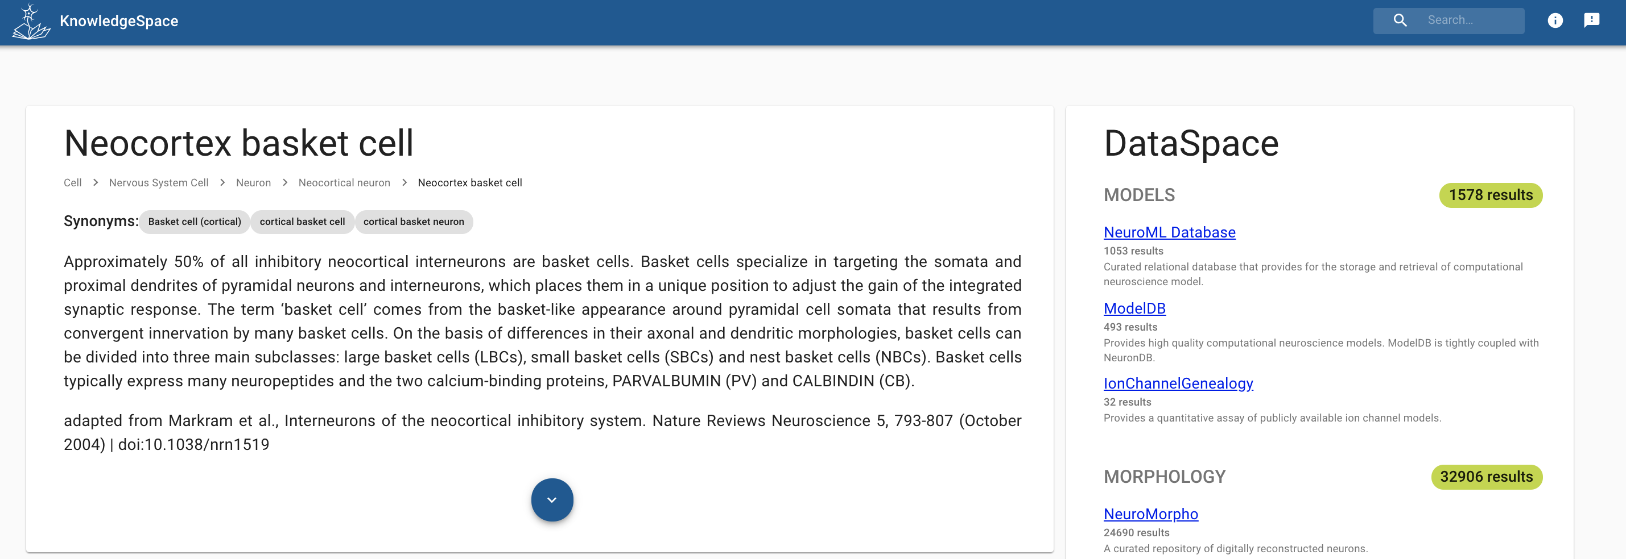

Slide 12
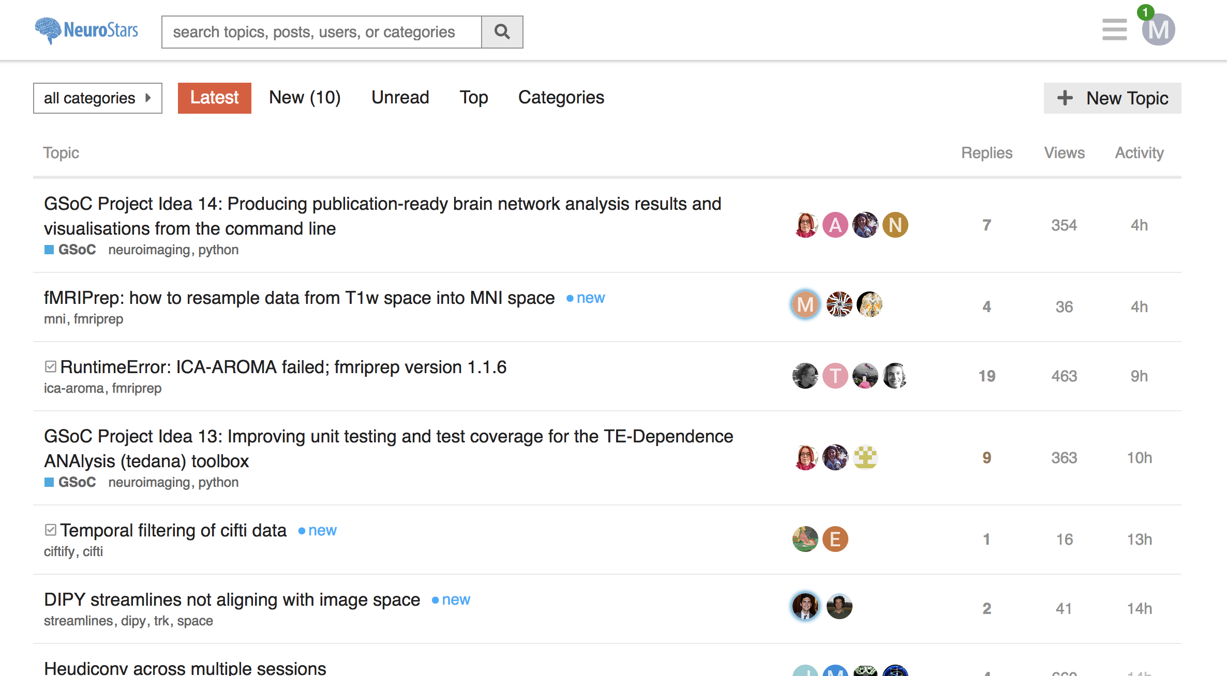
Question and answer forum
NeuroStars (2018 stats)
Registered users: 706
Visits: 29.600
Page views: 1.5 million

Slide 13
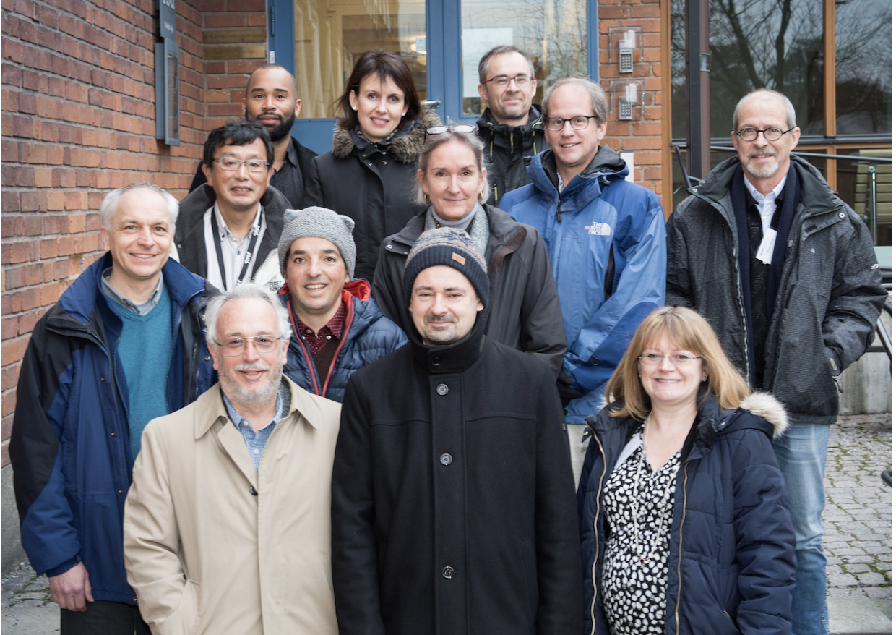
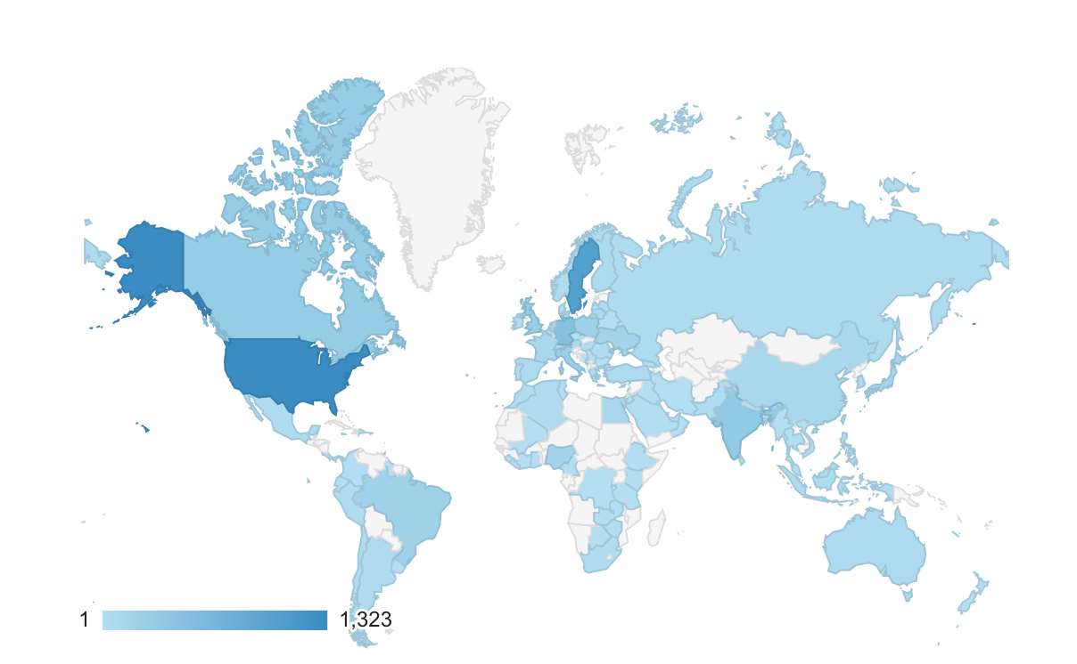
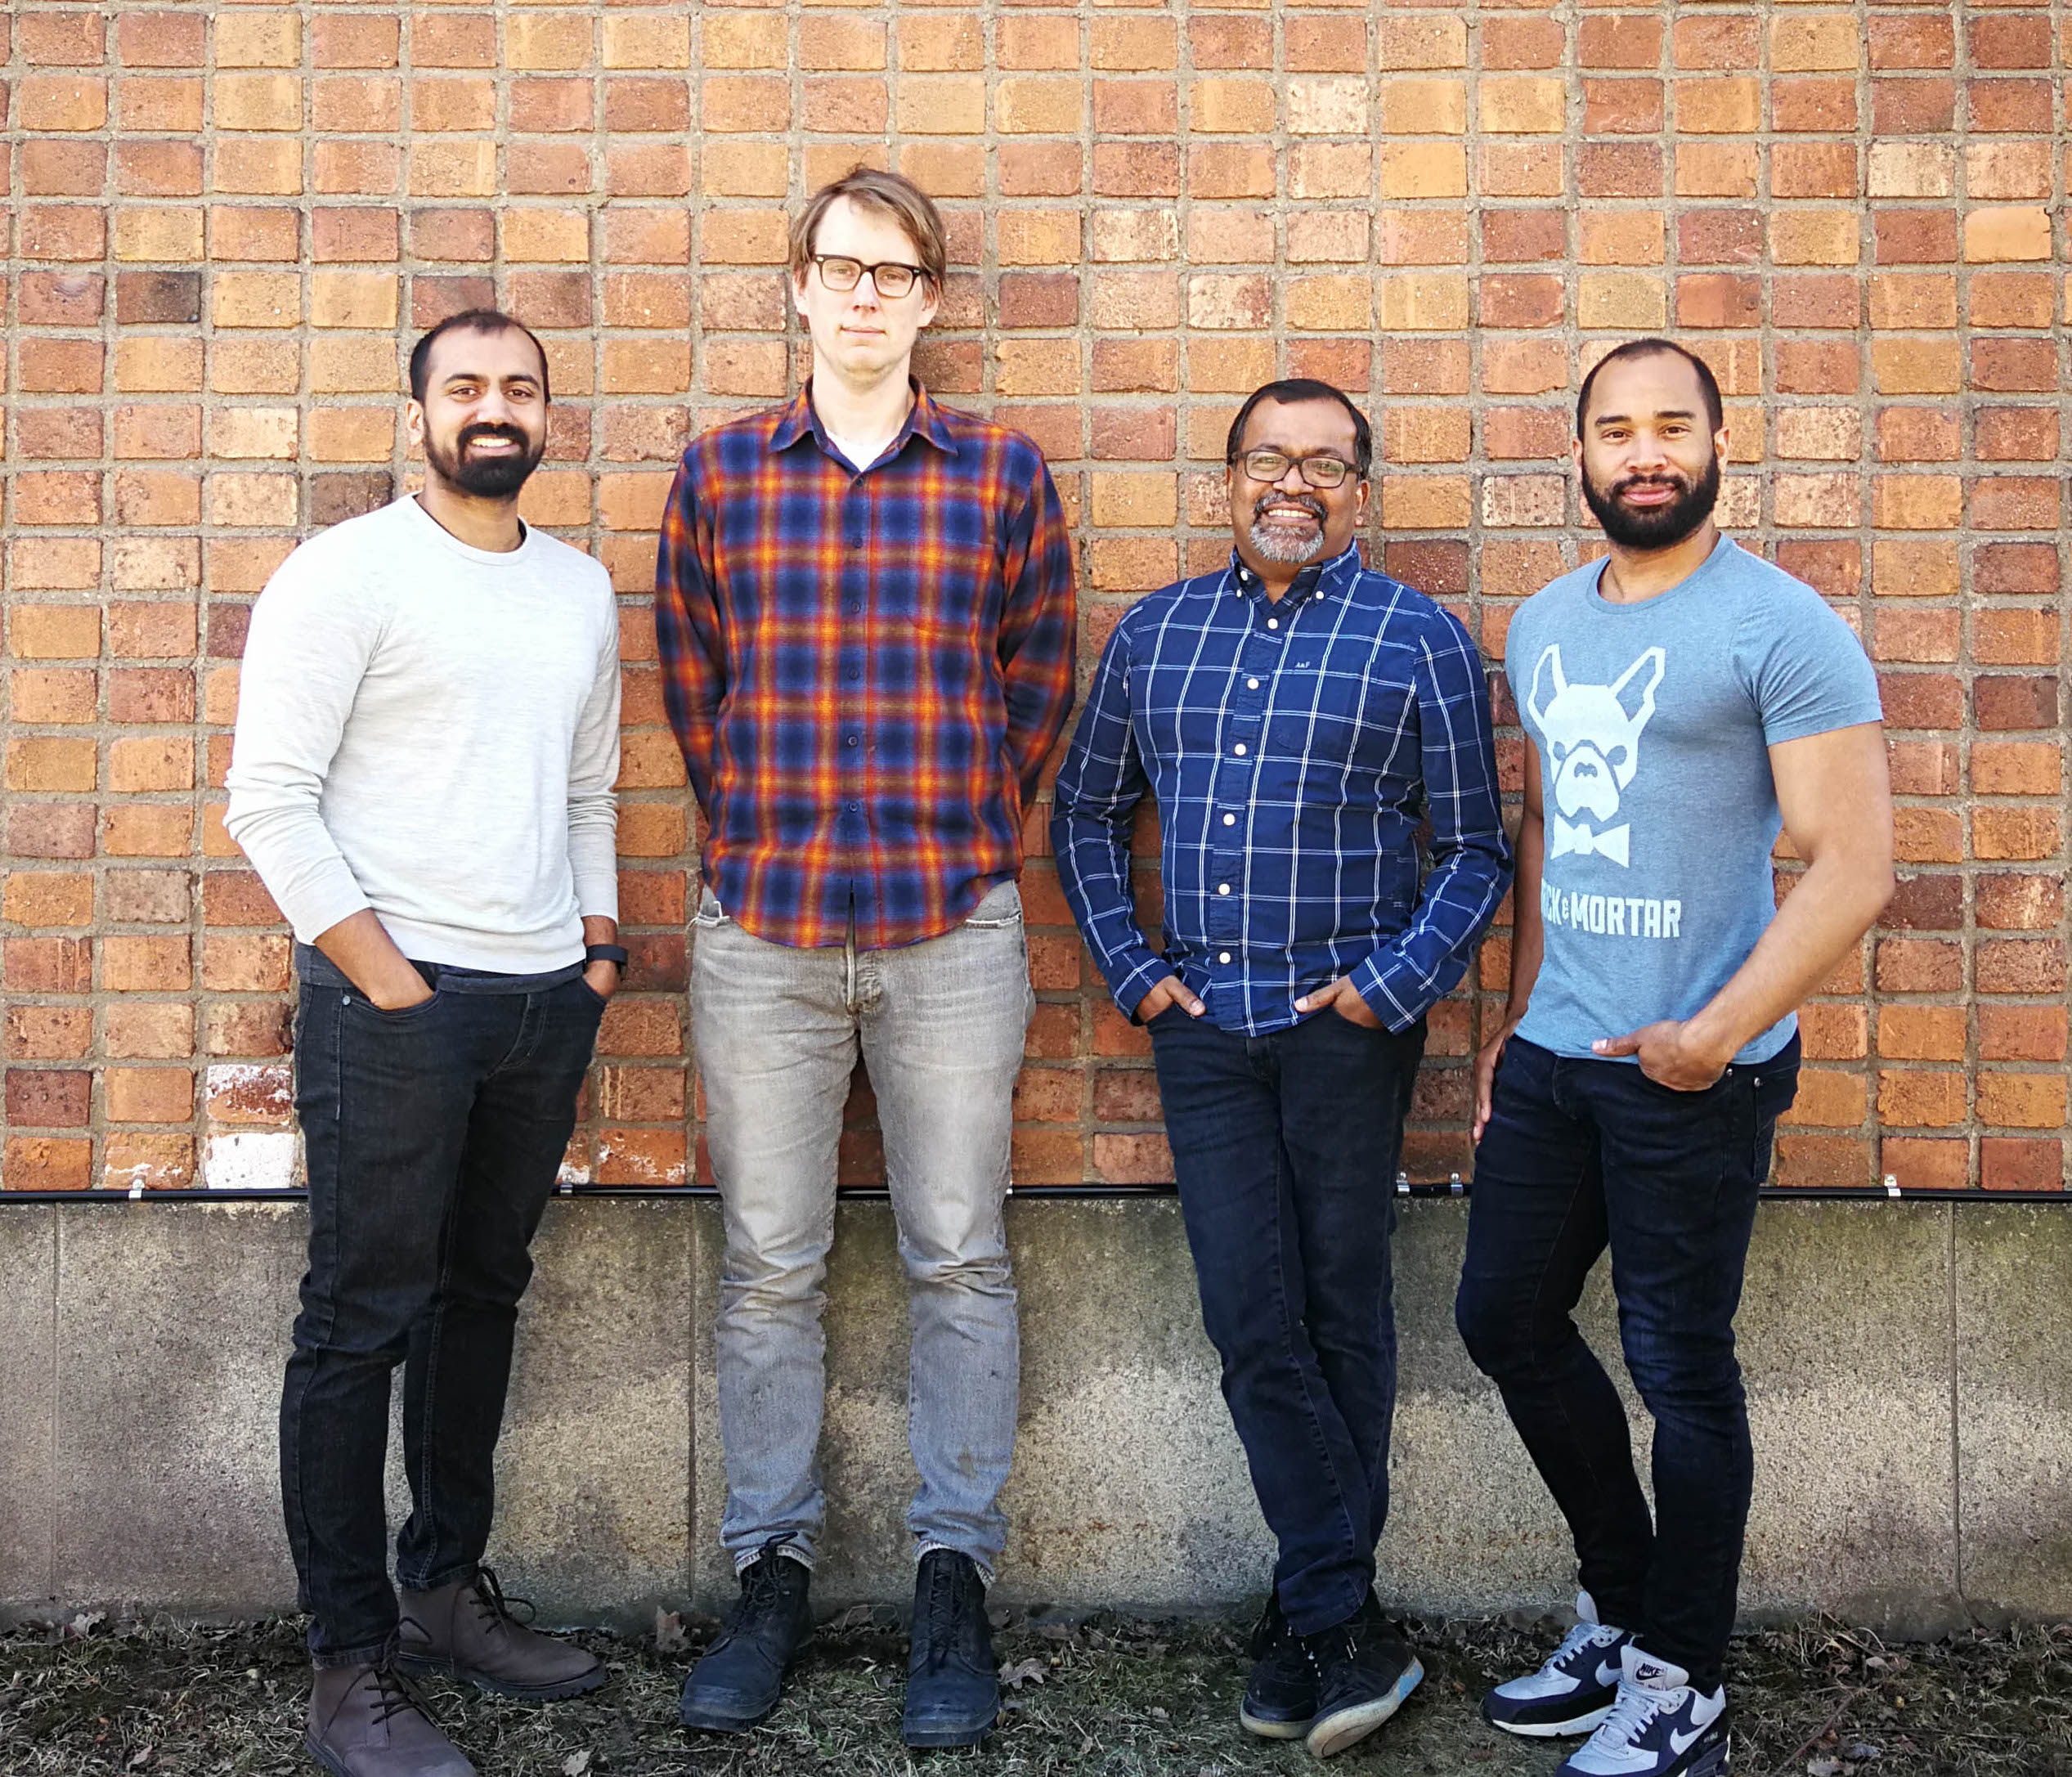
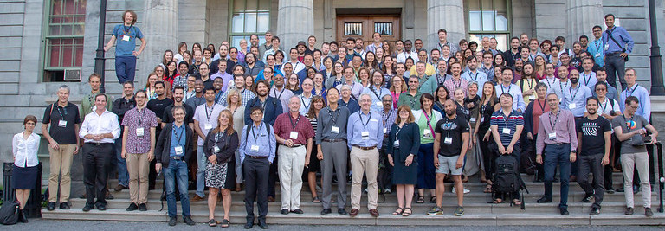
Acknowledgements
INCF Training and Education Committee
Jane Roskams (chair), Uni British Columbia/CONP
Stephanie de la Rochefoucauld (deputy chair), IBRO
Jack Van Horn, Uni Southern California/BD2K
Thomas Wachtler, Ludwig-Maximillians Uni
Gaute Einevoll, Norwegian University of Life Sciences
William Grisham, UCLA/iNeuro
Ariel Rokem, Uni of Washington
Alois Saria, Innsbruck Medical Uni/HBP
Ausra Saudargiene, Vytautas Magnus Uni
Daniel Wójcik, Nencke Inst/FENS
JB Poline, McGill Uni/OHBM
Tasia Asakawa, IBRO, IBI
Researchers, instructors, and students
TrainingSpace Development Team
Visakh Muraleedharan, INCF
Chris Fitzpatrick, INCF
Pradeep George, INCF
Mathew Abrams, INCF
Special thanks to all our content providers and the INCF community

