Slide 1
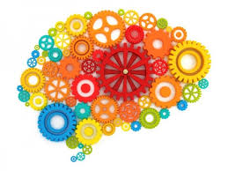
The Effect of Environment and Experience on the Brain
Angela May O’Connor
@amayoco
Notes:
Welcome to the science of enrichment symposium, thank you to organisers

Slide 2
Everybody has a brain, but not everyone shares the same environmental stimuli
Sensory Experiences
Nutrition
Stressors
Illness
What evidence is there for the effect of environment and experience on the brain?
Motor experience
Social interactions

Slide 3
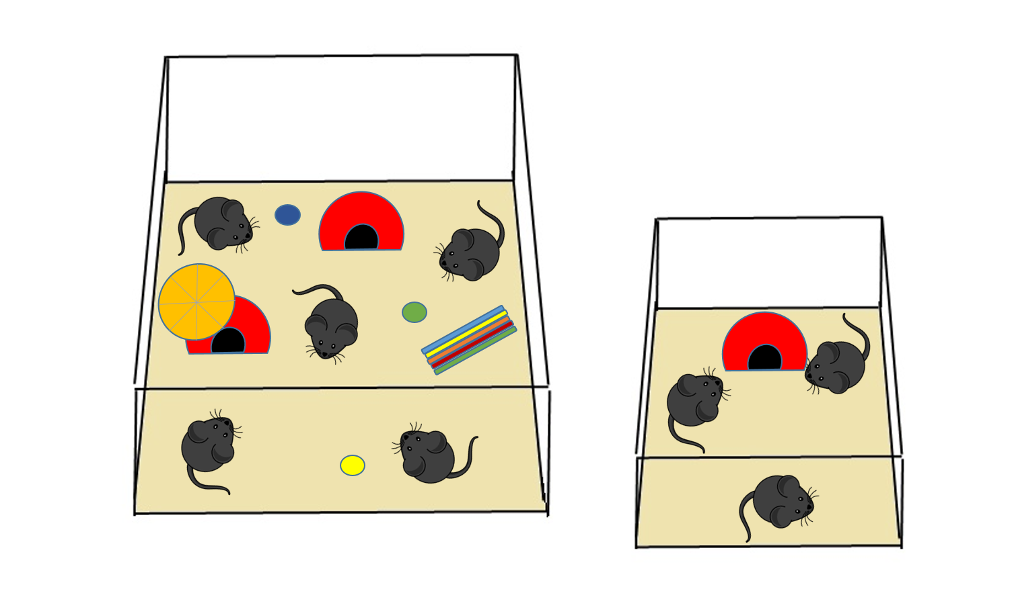
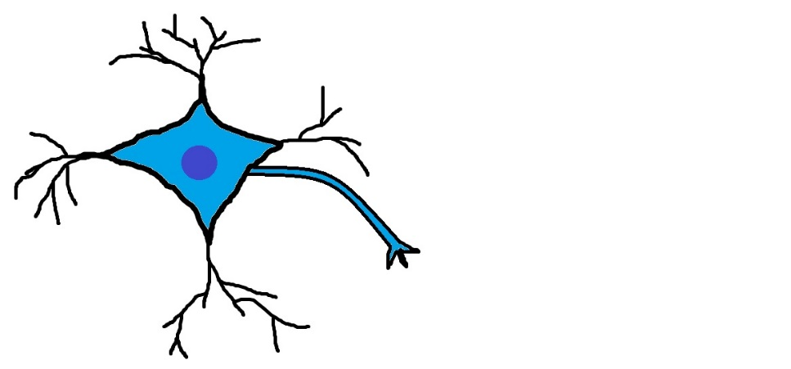
Environmental Enrichment
Increased motor, sensory and social stimuli
Makes brains heavier, more active, more complex, and improves cognitive behaviours
Notes:
EE – provides more complexity than would usually be encountered in lab housing
Variety of stimuli – used individually, used in combination
Different species/animals vary in what they find enriching – mice space, rats novelty
EE is a useful tool for investigating impact of environment on both general brain health and in animal models of neurological diseases/disorders

Slide 4
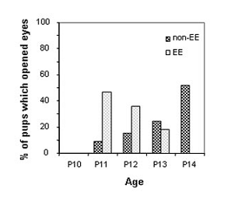
Environmental Enrichment Accelerates Sensory and Motor Development
N
E
Landi et al, 2007
Simonetti et al, 2009
Notes:
Several groups have investigated EE in visual system of mice.
Same findings; accelerates visual maturation, to the point where eyes open earlier.

Slide 5
Environmental Enrichment Improves Cognitive Performance
O’Connor et al, 2014
Notes:
My graduate work; looking at learning and motivation behaviours in mice.
Used Puzzle-Box – explain how it works.

Slide 6
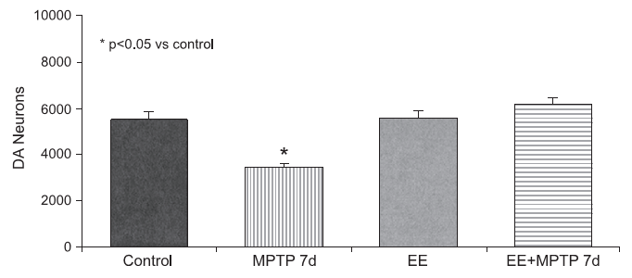
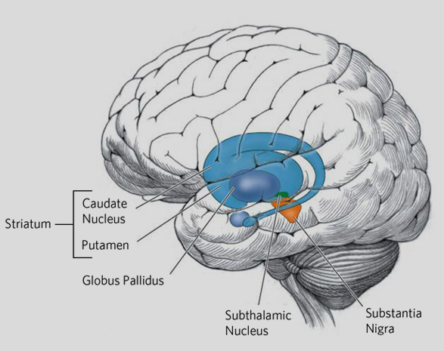
Environmental Enrichment Slows Neurological Disease Progression in Mouse Models
Parkinson’s Disease – neurodegenerative disorder impacting dopaminergic (DA) neurons
MPTP - 1-methyl-4-phenyl-1,2,3,6-tetrahydropyridine
Faherty et al, 2005
Notes:
My graduate work; looking at learning and motivation behaviours in mice.
Used Puzzle-Box – explain how it works.

Slide 7
Environmental Enrichment Slows Cancer Progression in Mouse Models
Cao et al, 2010
Notes:
My graduate work; looking at learning and motivation behaviours in mice.
Used Puzzle-Box – explain how it works.

Slide 8
Effects of environmental enrichment on laboratory animals are many and varied, but what does environmental enrichment/experience have to do with the human nervous system?

Slide 9
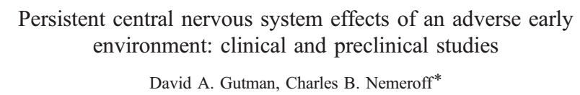
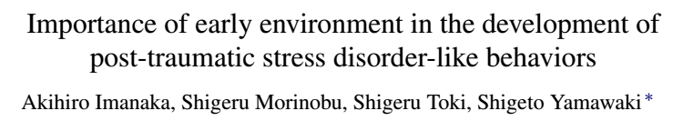
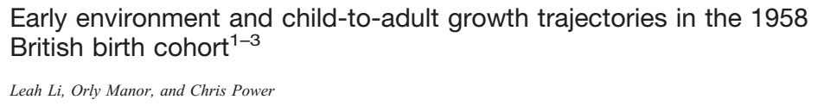

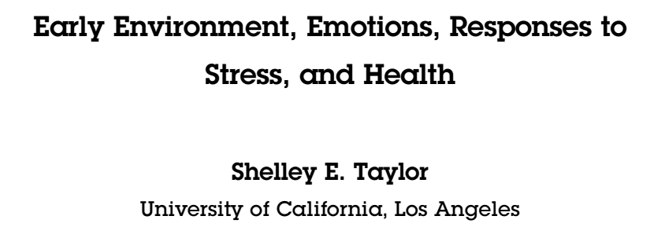
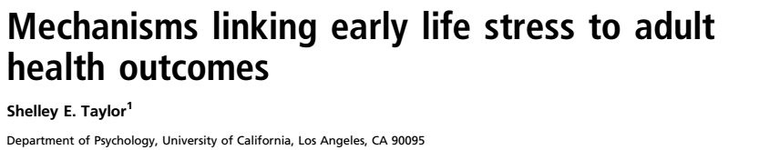
Environment (especially early-life conditions) has rather a lot of effect on human brain and behaviour

Slide 10
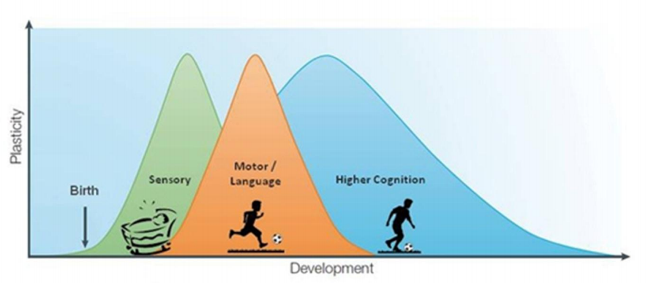
Human Brain Development 101
Mature brain (24ish)
Hensch & Bilimoria, 2012
Critical Period 1:
Birth – 10 years of age
Language
Sensorimotor
Vulnerable to sensorimotor defects; early-life stress
Critical Period 2:
Adolescence (12 – 24 years of age)
Emotion/Reward
Cognitive
Vulnerable to mood disorders; negative social experiences
Retains some plasticity into adulthood, but is never again as malleable/vulnerable

Slide 11
Critical Period – a time of plasticity
Results from timing mismatch in excitatory and inhibitory circuitry
Excitation followed by inhibition (which improves signal-to-noise ratio) and molecular “brakes”

Slide 12
So the early-life environment is also important for human brain development and function: can we use what we know from animal environmental enrichment studies to impact human brains?

Slide 13
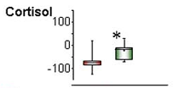

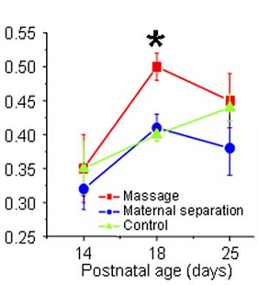
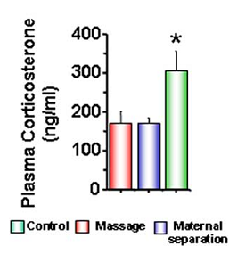

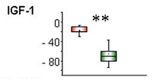
Yes - Direct Comparison of Animal and Human “Enrichment”
Massaged rat pups & human infants:
higher IGF-1; lower corticosterone/cortisol
Guzzetta et al, 2009

Slide 14
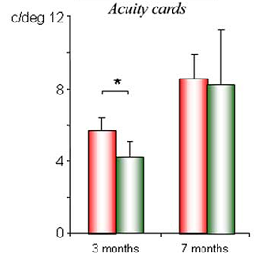
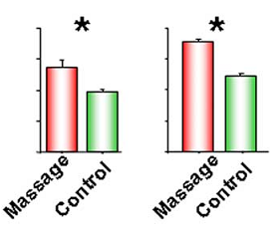


Yes - Direct Comparison of Animal and Human “Enrichment”
Massaged rat pups & human infants:
accelerated visual acuity
P25 P28
Guzzetta et al, 2009

Slide 15
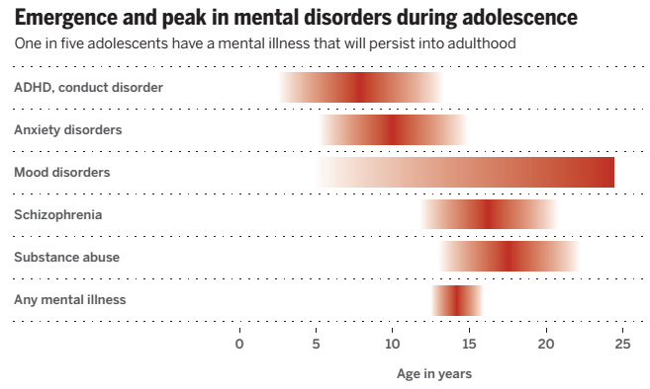
The Majority of Mental Illness Emerges During Critical Periods
Anxiety, mood and neuropsychiatric disorders are extremely common, debilitating and costly
Lee et al, 2014

Slide 16
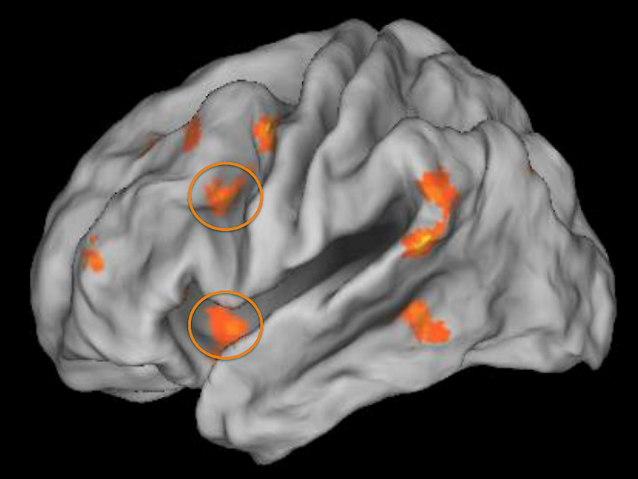
Neural Health is Tied to Early-Life Stress and SES
Early-life stress is a LARGE risk factor for developing anxiety/mood disorders
Children in low SES situations experience greater early-life stress, such as nutritional deficits
Prefrontal cortex activity
Amygdala activity
22% of all US children live below the poverty line (and 45% live in low-income)
Kim et al, 2013

Slide 17


Long-term early-life “enrichment” in humans
Island of Mauritius Child Health Project begun in 1972
WHO – can early-life interventions ameliorate effects of poverty?
Normal Childcare | “Enriching” nursery care
Adult:child ratio 1:30 | Adult:child ratio 1:5 to 1:10
5 hours/day | 7 hours/day
No food or hygiene education provided | Hygiene and nutrition
Basic reading/writing/counting | Cognitive tasks
1 hour/day physical activity | 2 hours/day physical activity
No field trips | Field trips
No medical screening | Medical screening
No nap-time | Parental involvement
Physical punishment | Social-emotional education
Notes:
WHO study on Mauritius in 1972
Explain enriching nurseries vs normal care
Many tests done; main findings are decrease in psychopathologies

Slide 18
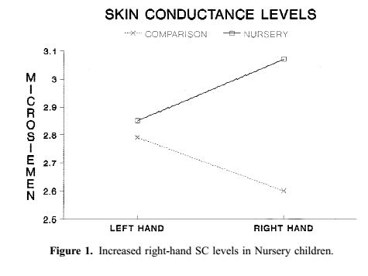
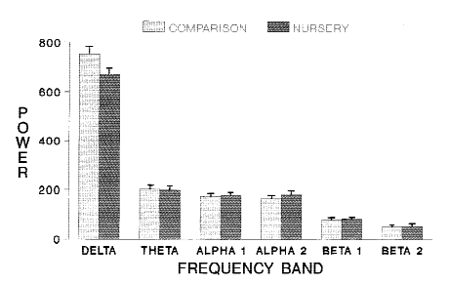
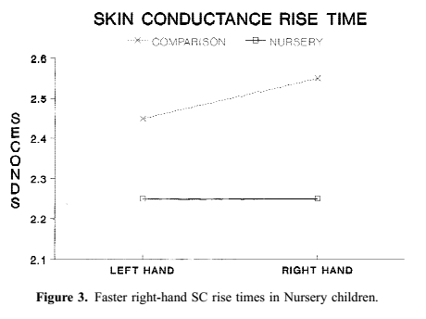
Early-life “Enrichment” Increases Arousal (reflexes), Orienting (attention) and IQ at Age 11
Raine et al, 2001
Notes:
WHO study on Mauritius in 1972
Explain enriching nurseries vs normal care
Many tests done; main findings are decrease in psychopathologies

Slide 19
Early-life “Enrichment” Decreases Later-life Psychopathology
Follow-up at 17 and 23 years of age showed:
in antisocial behaviour and hyperactivity (17)
in criminal offending (23)
in schizotypal personality (17 & 23)
Raine et al, 2003, 2010
Notes:
WHO study on Mauritius in 1972
Explain enriching nurseries vs normal care
Many tests done; main findings are decrease in psychopathologies

Slide 20
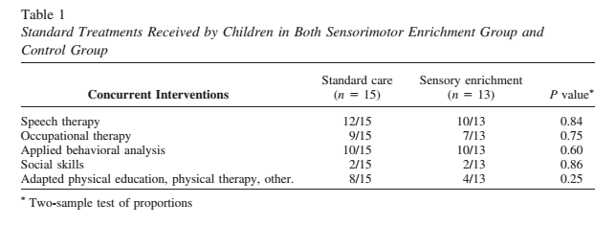
Sensorimotor Enrichment Therapy for the Treatment of Neurodevelopmental Disorders
Male subjects 3 – 12 years of age previously diagnosed with Autism
6 months of treatment
15 receive standard care
13 receive sensorimotor enrichment:
Cognitive (language, object matching)
Sensory (olfactory, tactile, auditory, thermal, visual)
Motor (manual manipulation, obstacle courses, balance)
Woo and Leon, 2013
Notes:
Sensorimotor enrichment therapy:
Sensory: olfactory, tactile, auditory, thermal, visual
Motor: manual manipulation, obstacle courses, balance
Cognitive: language, object matching

Slide 21
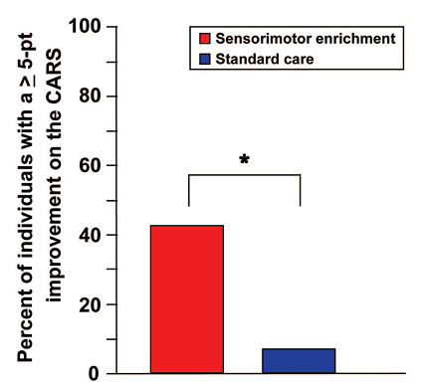
Sensorimotor Enrichment Therapy Improves Autistic Symptoms
6 months of sensorimotor enrichment reduced symptom severity as measured by the mean Leiter score and Childhood Autism Rating Scale (CARS)
Woo and Leon, 2013
Notes:
Similarly, enrichment is useful for neurological disorders
Study looking at sensorimotor enrichment for autistic children
Explain enrichment and results

Slide 22
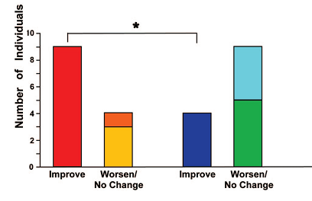

Sensorimotor Enrichment Therapy Improves Autistic Symptoms
6 months of sensorimotor enrichment reduced symptom severity as measured by parent/carer assessment
Woo and Leon, 2013
Notes:
Similarly, enrichment is useful for neurological disorders
Study looking at sensorimotor enrichment for autistic children
Explain enrichment and results

Slide 23
Overall Conclusions:
The environment you inhabit DOES MATTER (whether you are a rodent or a human)
Life-experience accrues and has biological effects
Environmental interventions are a cost-effective and relatively simple way to offset the effects of early-life stress and poverty – early childhood education programs!

Slide 24
What can we do in our lives?
Infant massage
Ensure young children have adequate nutrition
Monitor any potential for sensory or motor deprivation
Language! 30 million word “gap”. Talking to young children and second (third/fourth) languages
As adults: continued education/learning, range of activities

Slide 25
Questions?

Slide 26
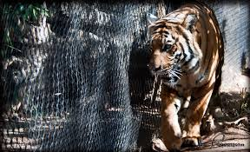
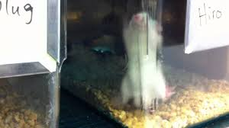
Environmental Enrichment Decreases Anxiety-Like Behaviours
Turner et al, 2003
Notes:
My graduate work; looking at learning and motivation behaviours in mice.
Used Puzzle-Box – explain how it works.

Slide 27
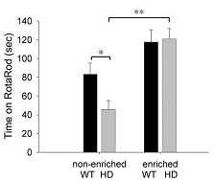

Environmental Enrichment Slows Neurological Disease Progression in Mouse Models
Huntington’s Disease – neurodegenerative disorder
Spires et al, 2004
Notes:
My graduate work; looking at learning and motivation behaviours in mice.
Used Puzzle-Box – explain how it works.

Slide 28
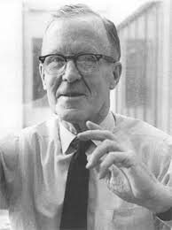

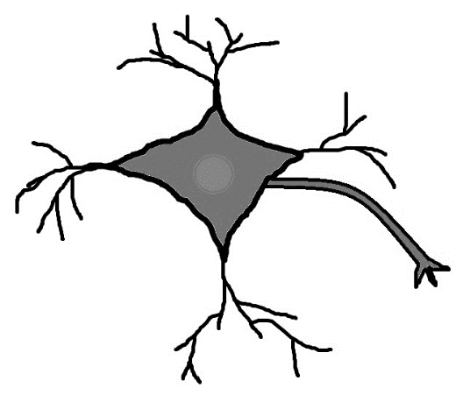
Environment Influences Animals’ Behaviour…
Donald Hebb – “cells that fire together wire together”
Hebb took rats home from the lab and noted improved cognitive abilities
“Environmental enrichment”
Formalised studies later on
Donald Hebb – 1940s

Slide 29
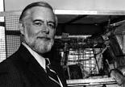

…and Animals’ Brains!
Brain weight, activity, and complexity
Posited that a rich environment is needed to fully develop brain and behavior
More recent studies have focused on particular systems and behaviours
Mark Rosenzweig -1960s

