Slide 1
Discussion on new IWXXM QVA report
26 Jan 2022

Slide 2
The requirements*
From METP/5 paper and subsequent WG-MOG discussions
Describes producers ✓ , consumers ✗ and use cases ✗
Describes functional and performance requirements of the report ✓
Describes payloads of the report
Describing the report itself ✓
Describing published (external) information ✓
Describing new information
Spatial property of the object (bounded space) ✓
Temporal property of the object (forecast) ✓
Other properties of object within the bounded space (concentration range) ✓
* As we are moving towards the provision of information services we may as well need to document how information is served

Slide 3
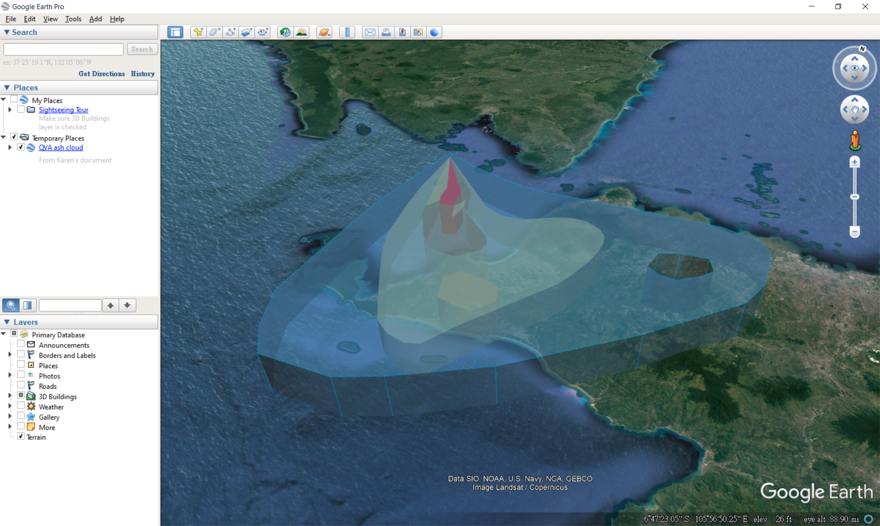

Slide 4
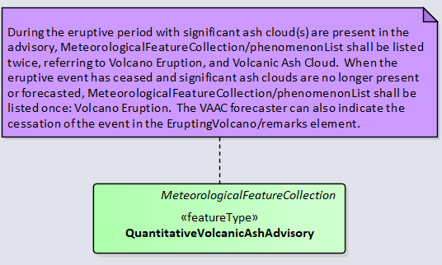
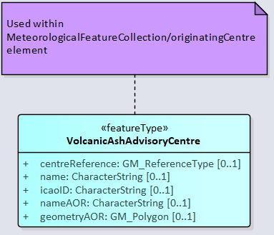
QVA UML Model
Leverage existing work done on WAFC’s SigWx product
QVA Product is an instance of a “MeteorologicalFeatureCollection”
QVA Components are “MeteorologicalFeatures” with attributes

Slide 5
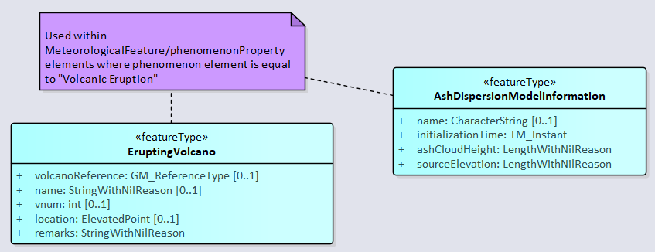
QVA UML Model
Characteristics of the Erupting Volcano

Slide 6
QVA UML Model
Volcanic Ash Cloud(s)
Needs a container with entries of varying concentrations in the WMO Code Registry

Slide 7
QVA Example in <oXygenML>

Slide 8
Question 1: References to published (external) information*
Published information is external to an IWXXM report and can be relatively static (e.g. VAAC) or dynamic (e.g. an eruption)
We used to copy published information in reports for completeness
It is desirable to include references to the authentic source in addition to the copied information
WMO has a codes registry which not only makes available published code lists online but also enables description of individual item in a code list with a URL. We may be able to make use of it in lists of records (e.g. volcano)
* Here it refers to information directly copied from external sources. If we add value to the information it is a different story

Slide 9
Question 2: Details of eruption
Following Question 1, which is the source of eruption details? VONA or VAA? Shall we include a reference to either or both of them? Or the eruption details included in QVA is value-added and no need for such reference?
Para. 2.5 of the METP/5 paper indicated that QVA will eventually replace VAA. Is that going to affect the decision above?

Slide 10
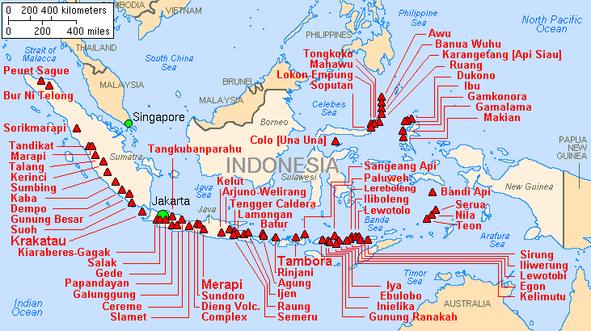
Question 3: Multiple plumes
It is presumed that a QVA will cover the ash clouds emitted from a single volcano. But what if:
There are multiple plumes from a single vent
The volcano has multiple and distinctive vents giving rise to separate plumes
There are separate plumes coming from nearby volcanos
* Can you find Volcanos Ruang and Raung?

Slide 11
Question 4: Do we want the report to have a fixed number of temporal features?
Ash clouds may forecast to disperse. We can either provide a feature at the target forecast time with nil concentration information, or just leave out the feature at the target forecast time completely.
Either should do but no matter the choice, we will need to specify it as a requirement to manage user expectation.

Slide 12
Question 5: Using gml:identity to uniquely identify features
It is by design that every WxObject published shall have a globally unique gml:identity.
gml:identifier
Often, a special identifier is assigned to an object by the maintaining authority with the intention that it is used in references to the object For such cases, the codeSpace shall be provided. That identifier is usually unique either globally or within an application domain. gml:identifier is a pre-defined property for such identifiers.
Content
Type based on xsd:string
Attributes
codeSpace as anyURI
We may want to formalize the use of codeSpace do discriminate different types of MET information. Views from WG-MOG are most welcome.

Slide 13
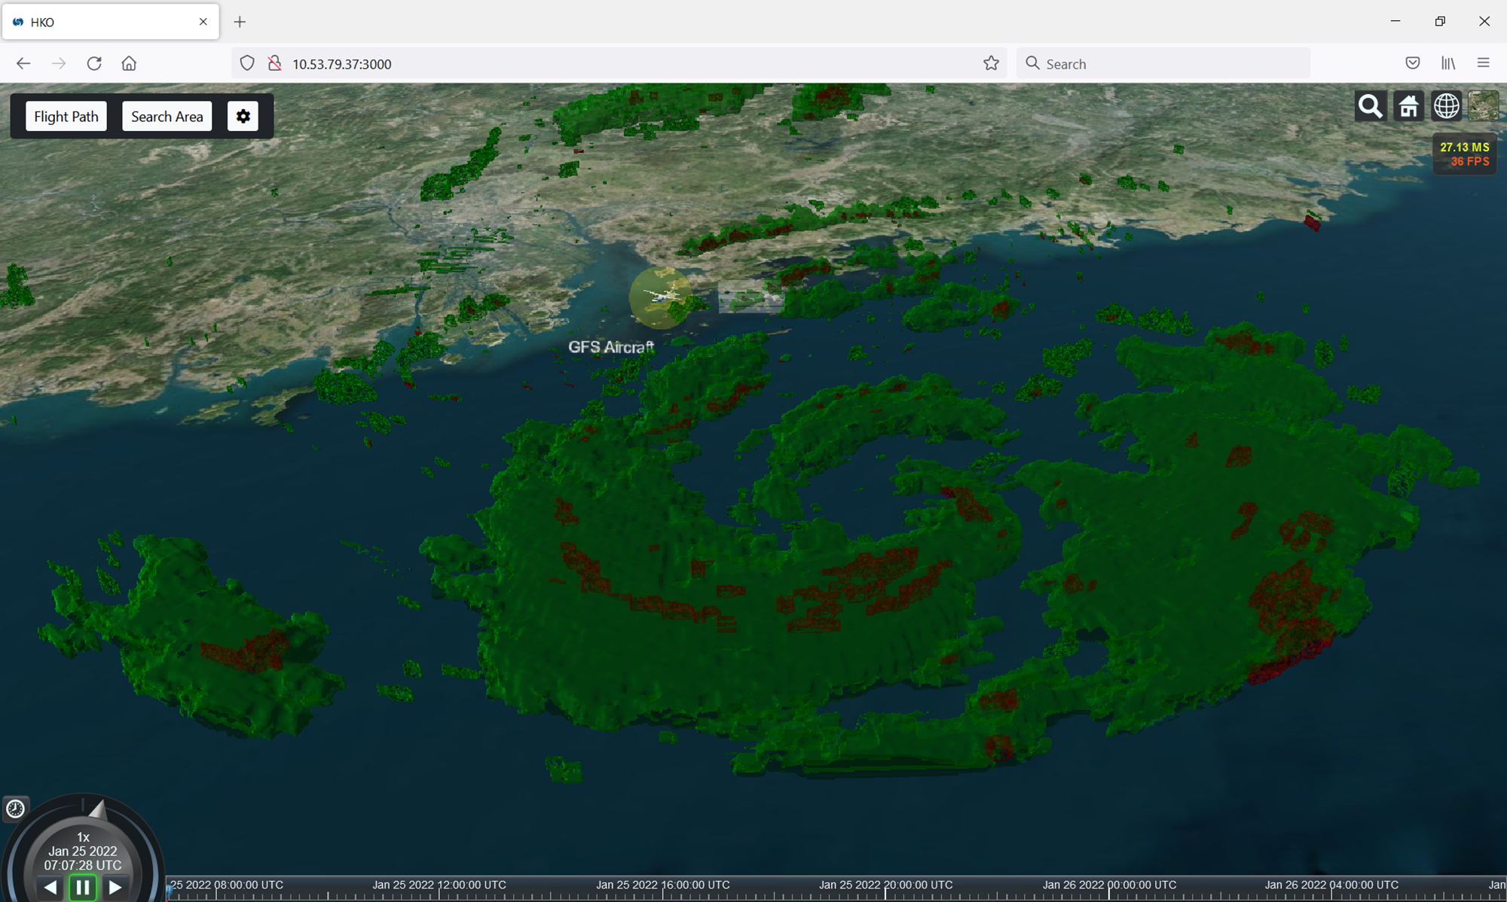
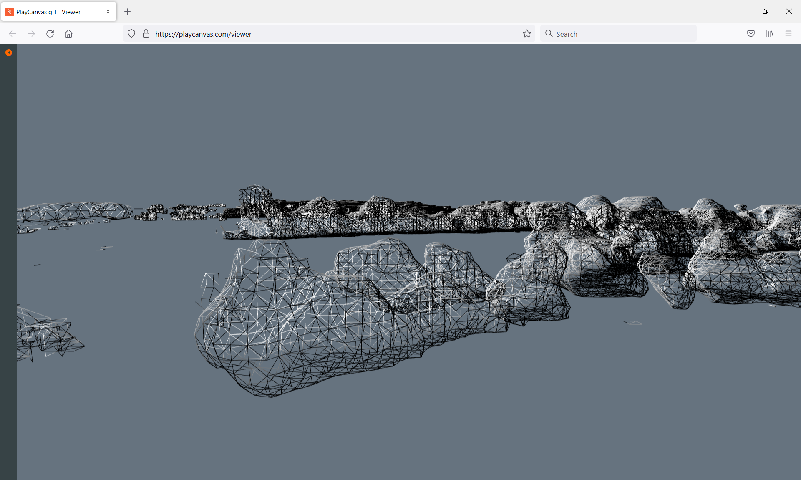
Question 6: Are we going to link up the iso-surfaces spatially and temporally?
There are of course benefits for linking up the iso-surfaces to form a complete, 3+1 dimention object but it may be difficult to do it automatically at the mean time. Let’s keep in view until a concrete use case appears.

Slide 14
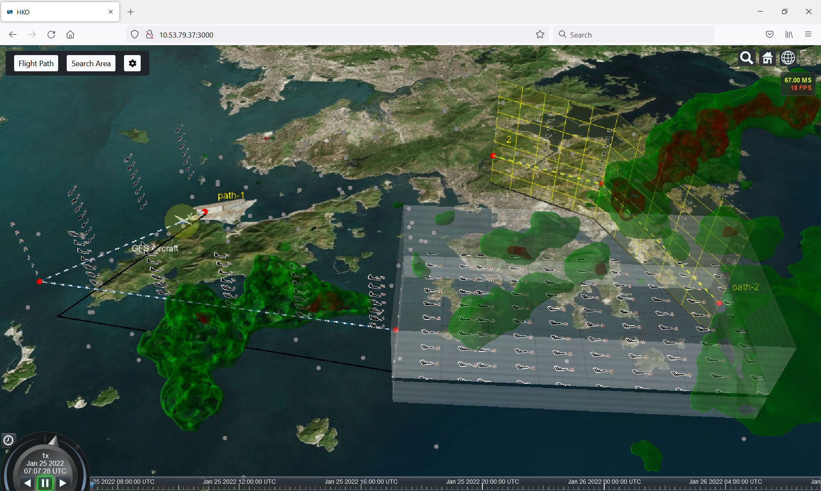

Slide 15
Thank you

