Slide 1
Automated Hand With Memory Project Presentation
Submitted By:-
Rohan V. Bodkhe
Shivam D. Patil
Sharad P. Malwale

Slide 2
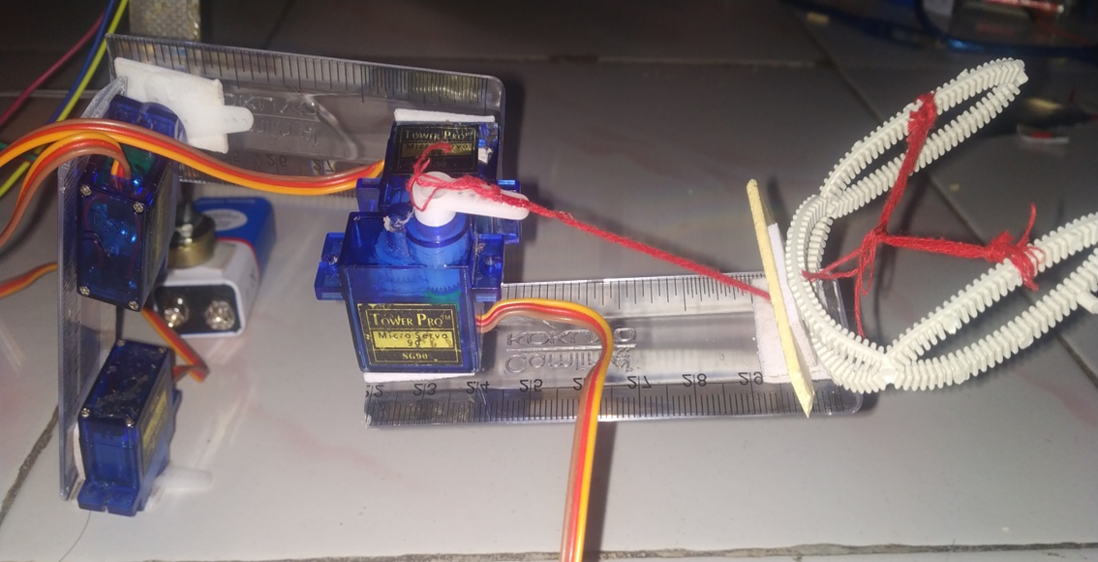
Automated Hand With Memory

Slide 3
Presentation Outline
Project Overview
Task Descriptions
Status

Slide 4
Robotic Arm Overview
Assists students in learning educational concepts.
Simulates the human arm.
Controlled using a SiLabs C8051F310 microcontroller.
Software developed in C (or assembly) using Silicon Laboratories software.

Slide 5
The Robotic Arm Shall:
be cost effective.
model a human arm.
have the ability to lift a tennis ball or full soft drink can.
be as safe as possible!

Slide 6
Educational Objectives
The robotic arm will teach students:
mechanics of the human arm and its movement.
control of the human arm.
about robotics and engineering.
basic circuitry.

Slide 7
Educational Outline
Human Arm Mechanics
Interaction between muscles and bones
Range of motion
Robotic Arm Mechanics
Sliders as individual inputs
Range of motion (more limited)
Gears and motors
Robotic Arm Engineering
Design Process
Basic Circuitry
Potentiometers (inputs)
Microcontrollers (brain)

Slide 8
Educational Activity
Task: Students will be required to move the Robotic Arm to a specified location and pick up small object.
Outcome: Students will learn about complexity of human arm movement.

Slide 9
Mechanical Design
The arm is constructed
Mounting of H-bridge drivers and micro in progress
Debugging mechanical operation
Elbow joint
Shoulder rotation servo
Forearm servo
Shoulder lift servo

Slide 10
Analysis of Mechanical System
Analyzed torque required to lift a one pound load.
Determined additional requirements for servomotor selection.
Strain and Stress analysis was not performed due to the fact that the arm will only move light loads.
Analyzed torque required to lift a one pound load.
Determined additional requirements for servomotor selection.
Strain and Stress analysis was not performed due to the fact that the arm will only move light loads.

Slide 11
Future Scope
Its use can be extended and exploited by few modifications to do difficult and hazardous tasks for industrial applications.
It can be used to do small assembly work effectively due to its great added accuracy for placement of parts, which is further extended scope of our project The machine provides motion to the end effectors in the theta and A directions. The end effecter can be a pair of pneumatic grippers, a set of multiple grippers, magnetic pick-up, vacuum pick-up etc. The device has its own in-built logic and all the movements of the device are controlled by the combination of control valve and reversible valve which form the vital part of the machine. $ single pulse of air given to the control valve activates the reversible valve and admits air alternately to the two pneumatic cylinders during one cycle.

Slide 12
Conclusion
Robotic arms, many areas are developable. Thanks to the robotic arms, many tasks are made easier and the resulting error level has been reduced to a minimum. For example; some pharmacy-based drug-giving robots and a projected robot arm have been developed. In addition to this, the ability to move the robot arm is further increased, and when the camera is placed in the finger area and the sensitivity is increased, it can be used in a wide range of applications from the medical sector to the automation systems. Despite the fact that the robotic arm made by this project is of prototype quality, it has a quality that can be improved for more robotic systems. Besides these, robotic arm sector, which is open to development, will keep its importance in the future. The purpose of the project is to provide control of 4 axes moving robot arm design and this robot arm with a suitable microcontroller and Bluetooth module with android application.

Slide 13
Thank You!

