Slide 1
Towards More Accurate Physics-Dynamics Coupling in the UFS
October 20, 2022
National Weather Service
Kevin Viner
NOAA/NWS/NCEP/EMC

Slide 2
What is PDC? Why is it important?

Slide 4
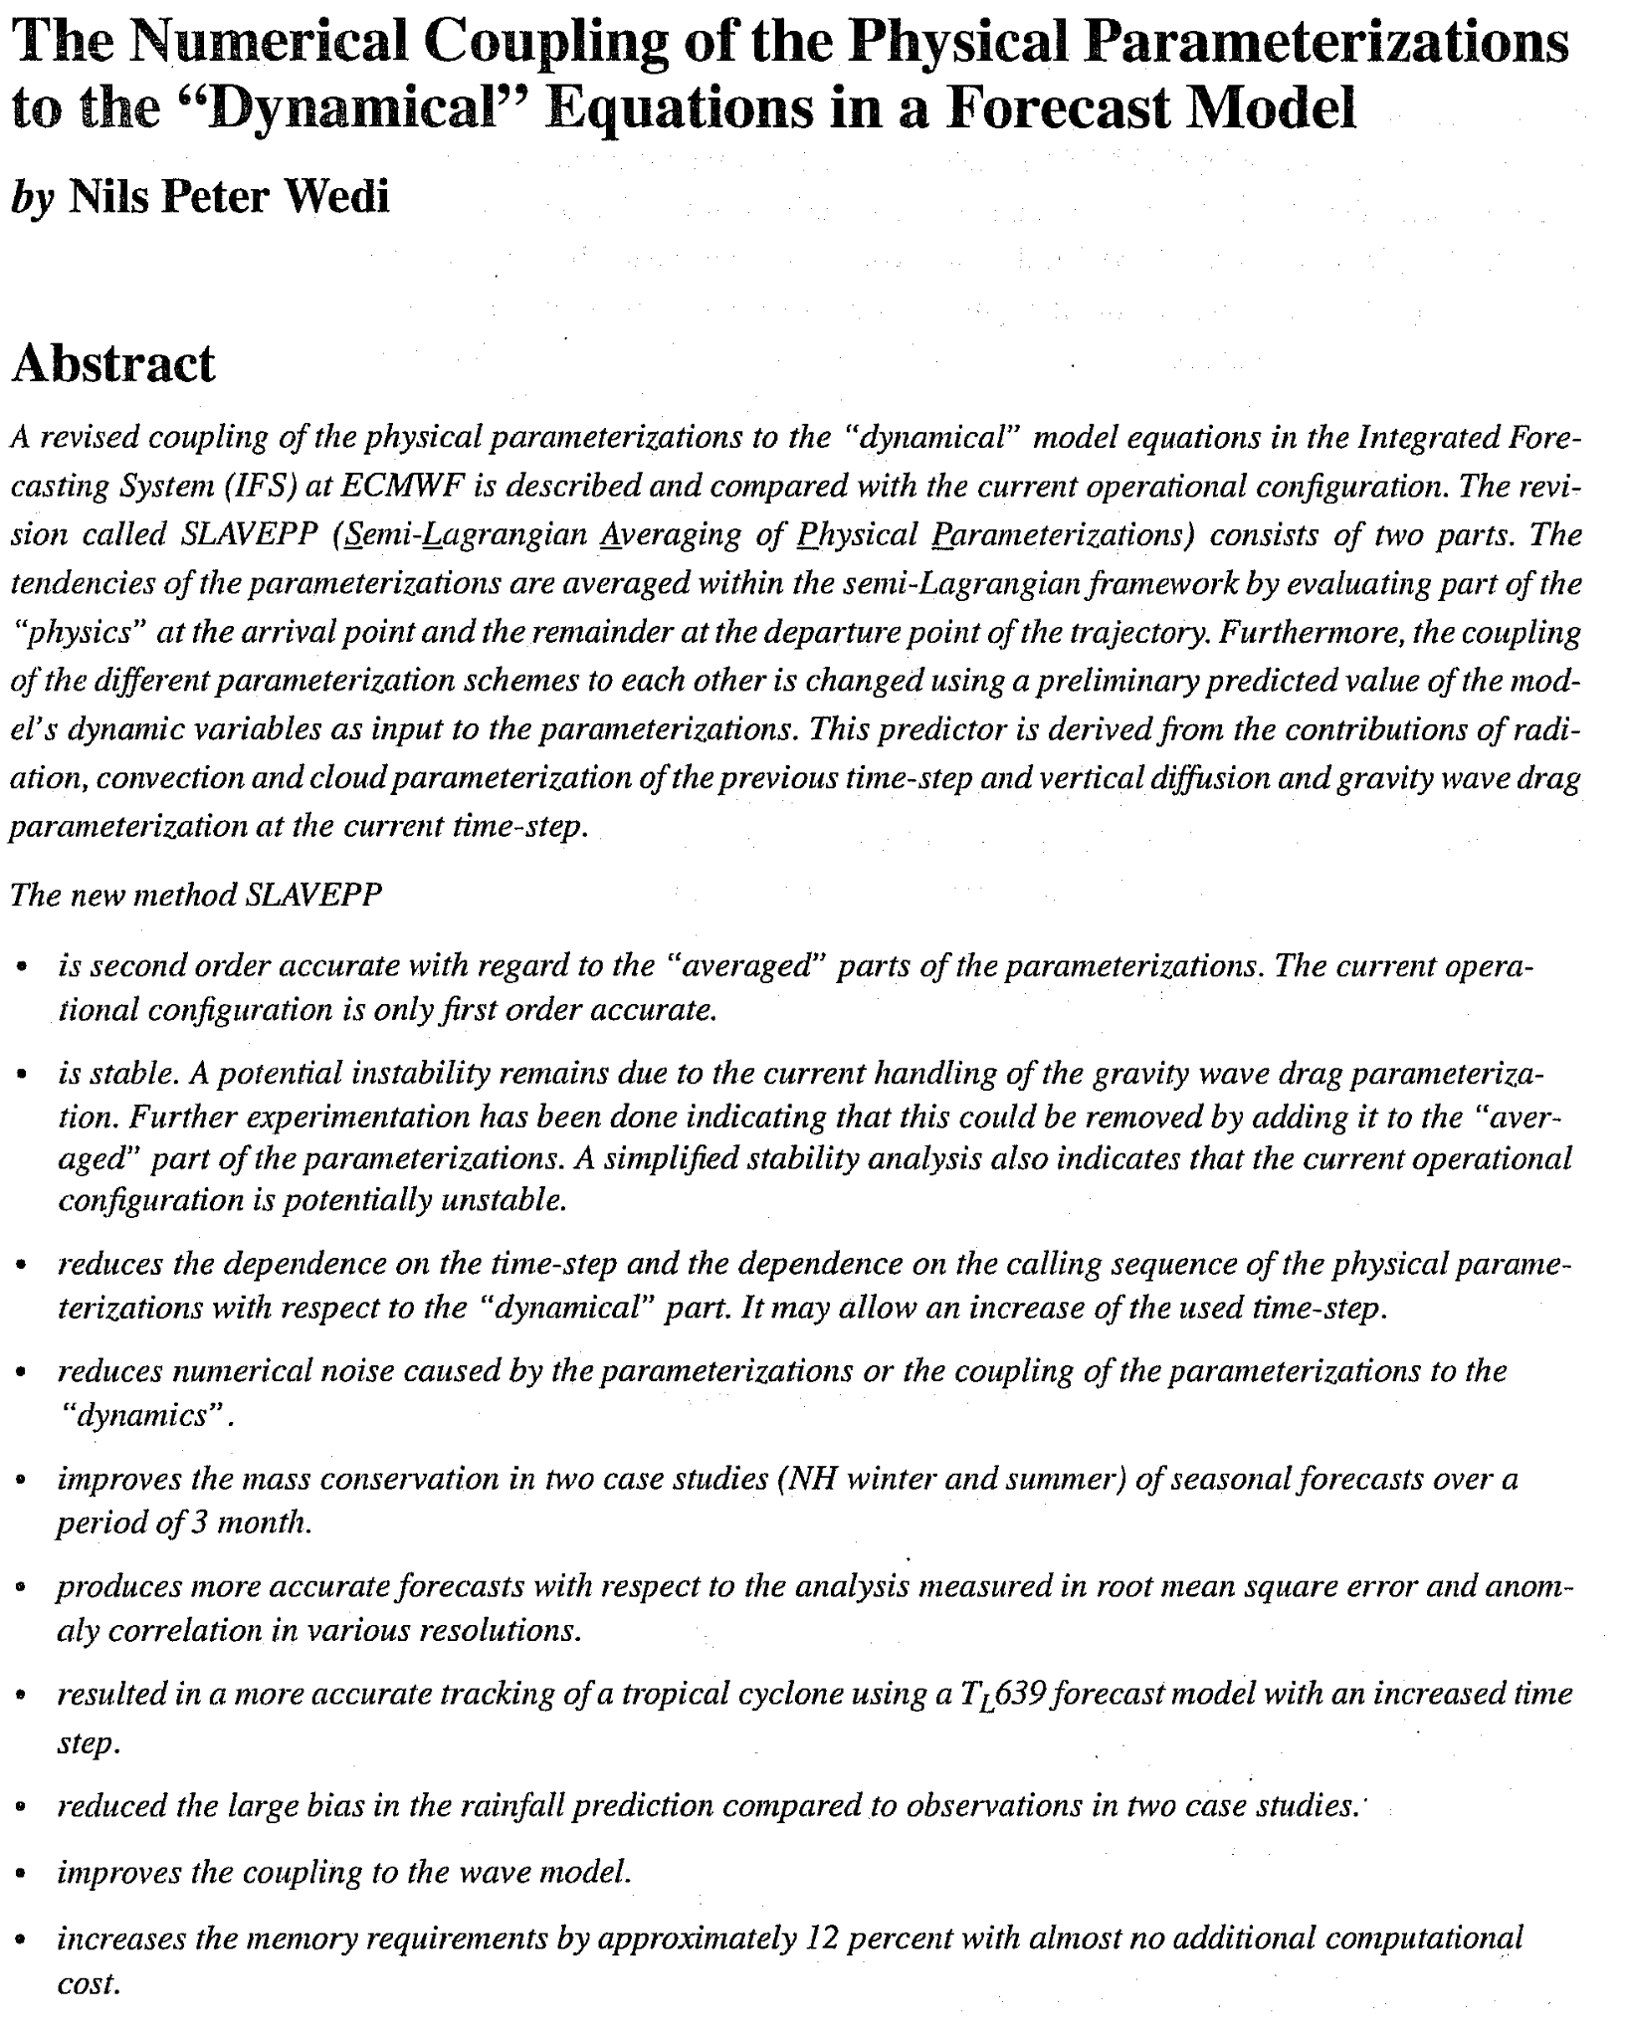
ECMWF tech memo 274 from 1999:
Details development of 2nd Order accurate SLAVEPP scheme for IFS
Reduces time-step dependence (~same answer regardless of dt) by eliminating first order physics truncation term
Why aren’t we paying attention to this memo?!

Slide 5
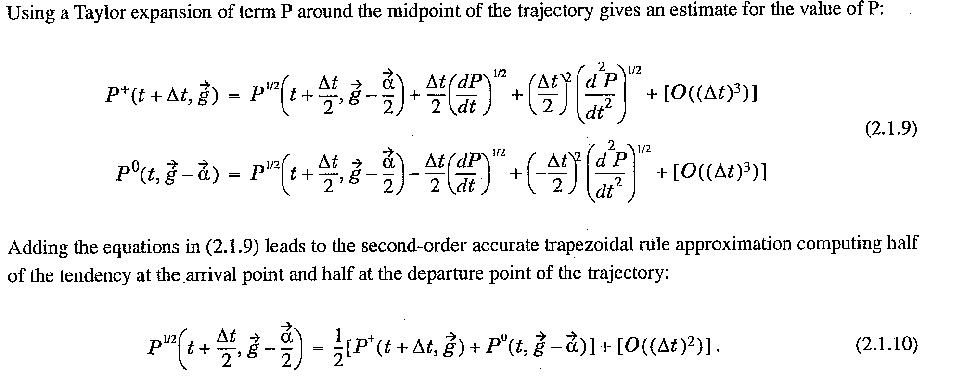
Physics truncation error

Slide 6
But UFS isn’t SL, Why does this matter?
UFS has a much larger time step than typical Eulerian models
Floating lagrangian vertical coordinate
Lin and Rood advection scheme in horizontal (CFL_{x,y}<1}
SL models generally use ∆t_SL ~ (5-10)*∆t_EUL
At these time steps time truncation error from PDC can become dominant term
UFS also uses ∆t_atmos=k_split *∆t_dyn
More prevalent in GCMs than NWP models
Calling dynamics multiple times before calling physics can make ∆t_atmos (the physics time step) on par with SL models

Slide 7
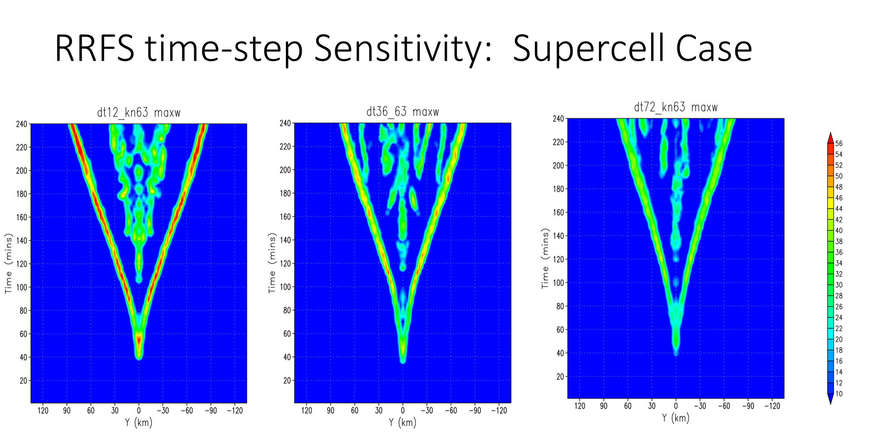
Is PDC a problem in UFS?
Results by Jili Dong and Kate Zhou

Slide 8
What else is out there?
What have other models done?

Slide 9
Notes:
Note that UKMO’s UM is somewhat similar

Slide 10
What about Eulerian model examples?
Physics schemes in this case is largely taken straight from IFS
see Zangl et al 2015 (QJRMS)
Notes:
Add Zangl reference

Slide 12
What did I choose?
To essentially reproduce the ECMWF tech memo with UFS

Slide 13
Proposed UFS Splitting
*Note that we cannot divide the physics tendencies into “fast” and “slow” components as yet. This is not a capability built into CCPP.

Slide 14
Implementation Details
Introduce a new namelist variable phys_decenter in fv_arrays and fv_control
Store tendencies for each variable in atmosphere_state_update; apply phys_decenter fraction of the tendencies at the end of the step
Pass the tendencies through fv_dynamics to dyn_core
Map the wind tendencies from A-grid to D-grid
Pass the wind tendencies to c_sw and all tendencies to d_sw
In c_sw map the wind tendencies from D-grid to C-grid and apply them as a RHS forcing times (1-phys_decenter)
In d_sw apply all tendencies as a RHS forcing times (1-phys_decenter)

Slide 15
Experiment Details
Run 4x120 hour forecasts at C384L127 for 2020010200
dt_atmos = 30s, k_split=1, n_split=6, phys_decenter = 1.00
dt_atmos = 600s, k_split=6, n_split=6, phys_decenter = 1.00
dt_atmos = 30s, k_split=1, n_split=6, phys_decenter = 0.50
dt_atmos = 600s, k_split=6, n_split=6, phys_decenter = 0.50
Compute MAE and RMS differences between the pairs of forecasts with different time steps to examine time step sensitivity (truncation error)
e.g., RMS(dt600-dt30)_pd1.0 vs RMS(dt600-dt30)_pd0.50

Slide 16
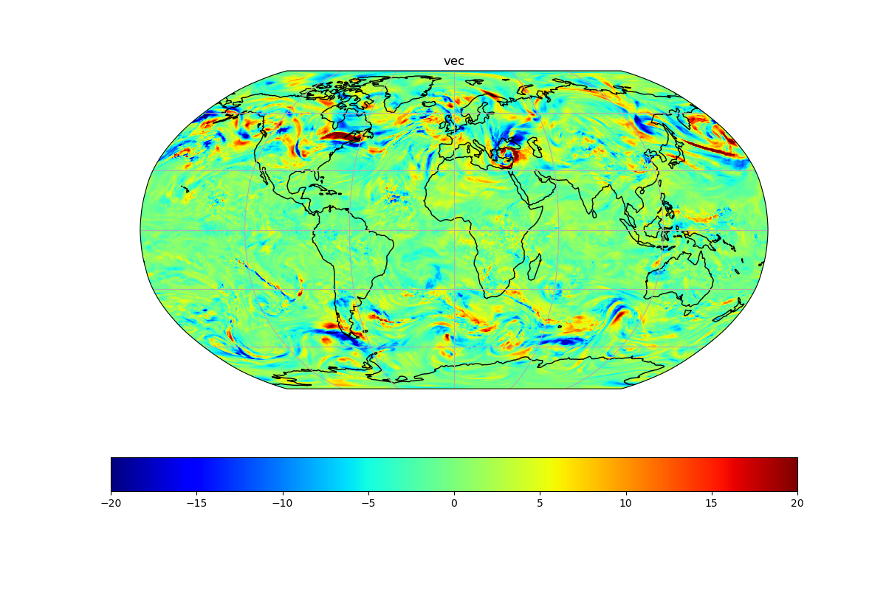
Example Differences at Tau=120h
500hPa Vector Winds; phys_decenter=0.50

Slide 17
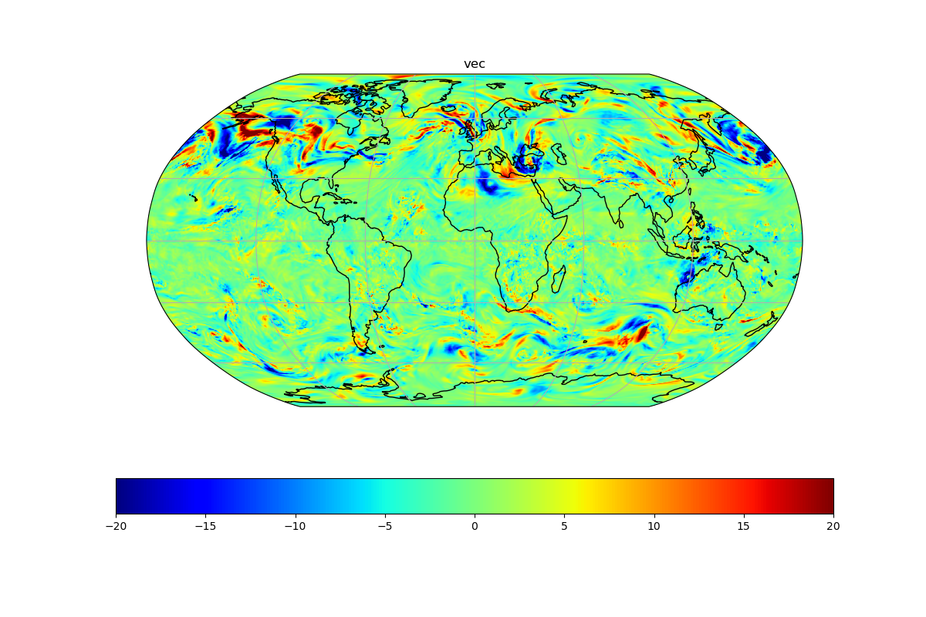
Example Differences at Tau=120h
500hPa Vector Winds; phys_decenter=1.00

Slide 18
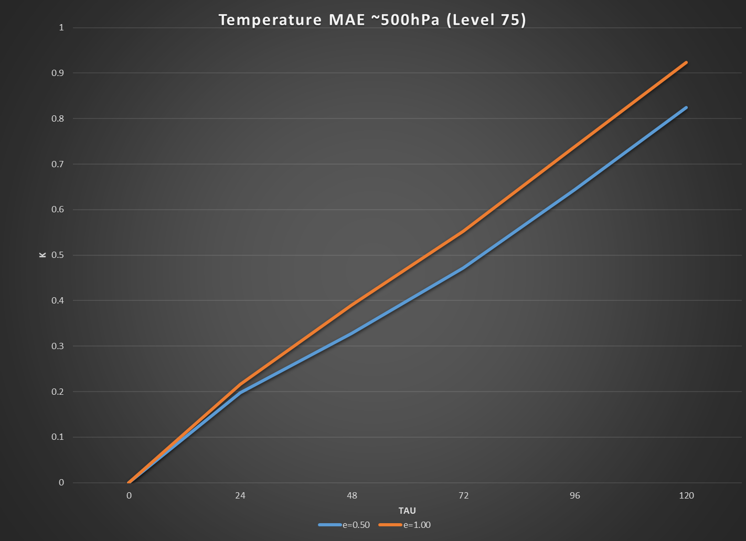
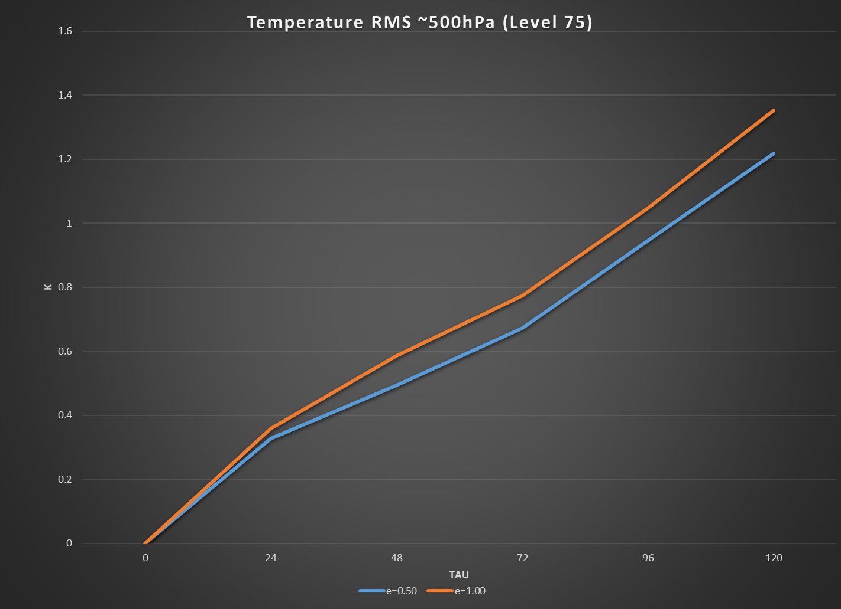
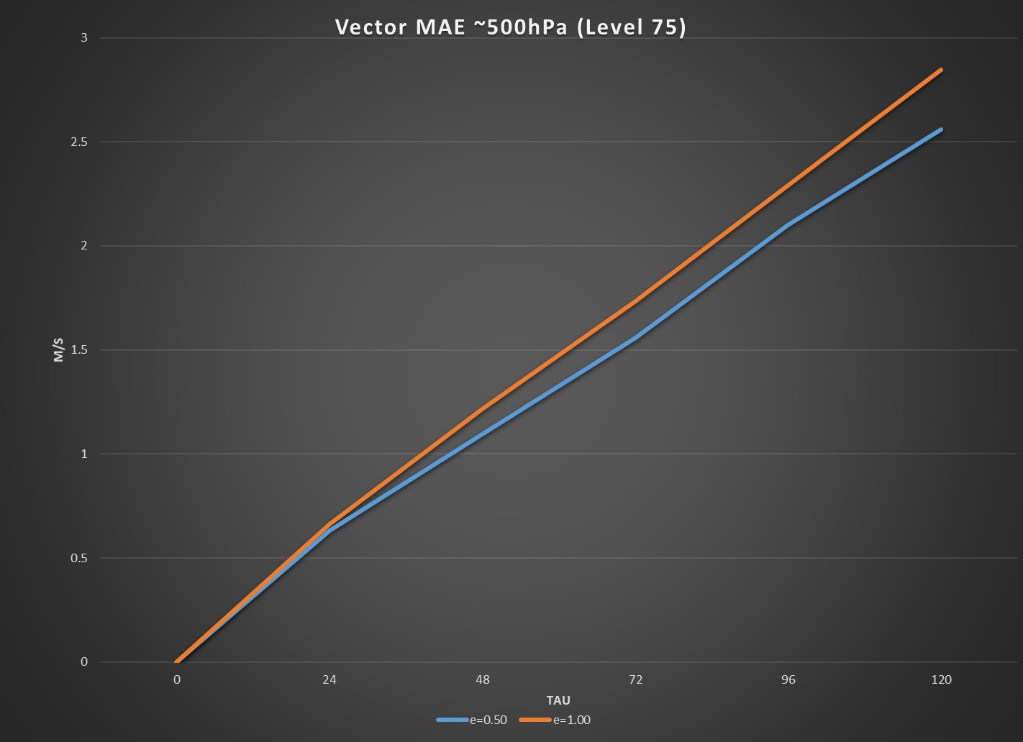
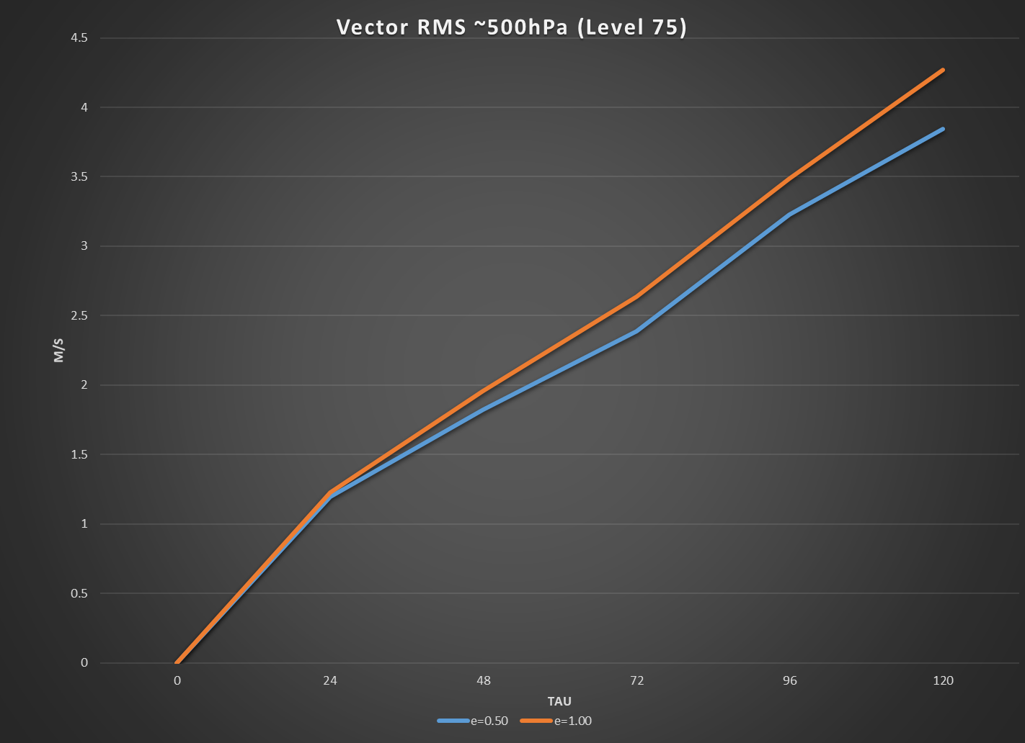
Time-step Dependence Results

Slide 19
So the time-step dependence is reduced, but do we have a better solution?
I don’t know yet. I haven’t had time to verify GFS forecasts or to ask others to try running cases with RRFS
I’ve only finished part one of…a few
Still need to re-evaluate how the physics is called
Physics is now based on the state at the end of dynamics (with old physics tendencies on RHS), whereas it was called based on the pure dynamical solution

Slide 20
Near Future Work
Run some tests with verification
supercell test case again
Some RRFS test cases to see character of convection
Verify a series of GFS forecasts
I expect a re-evaluation of the physics will be necessary to get a better solution and reduce the time-step dependence further
has this new code thrown off the tuning?
see SLAVEPP for info on more detailed coupling

