Slide 1
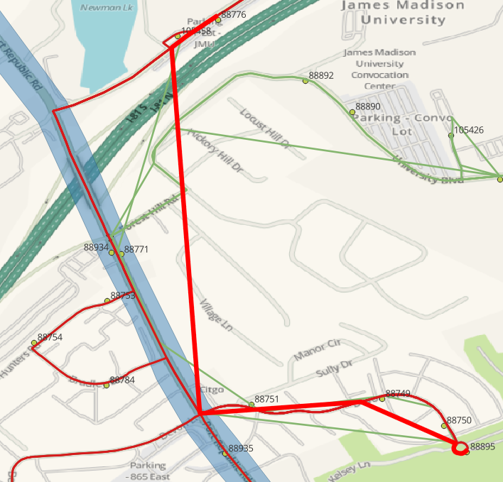
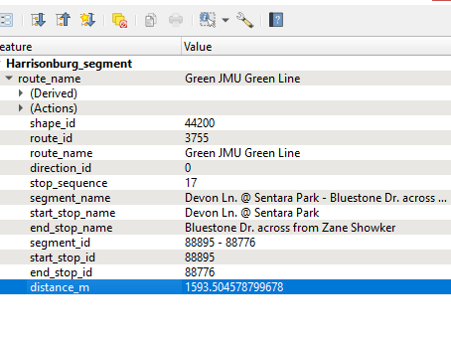
593687 | 7:16:12 | 7:16:12 | 88750 | 16 |  |  |  | 0 | Green
593687 | 7:17:24 | 7:17:24 | 88895 | 17 |  |  |  | 0 | Green
593687 | 7:18:36 | 7:18:36 | 88751 | 18 |  |  |  | 0 | Green
593687 | 7:19:48 | 7:19:48 | 88771 | 19 |  |  |  | 0 | Green
593687 | 7:21:00 | 7:21:00 | 88776 | 20 |  |  |  | 1 | Green
593687 | 7:23:00 | 7:23:00 | 88989 | 21 |  |  |  | 1 | Green
593687 | 7:24:00 | 7:24:00 | 88990 | 22 |  |  |  | 1 | Green

Slide 2
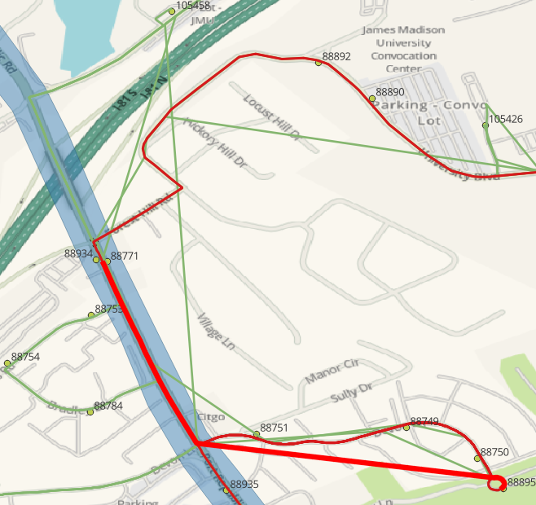
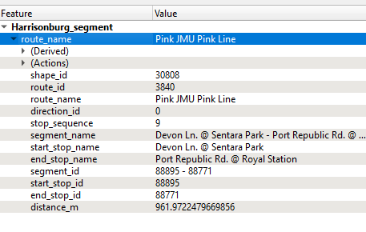
399801 | 7:09:45 | 7:09:45 | 88750 | 8 |  |  |  | 0 | Pink
399801 | 7:10:30 | 7:10:30 | 88895 | 9 |  |  |  | 0 | Pink
399801 | 7:11:15 | 7:11:15 | 88751 | 10 |  |  |  | 0 | Pink
399801 | 7:12:00 | 7:12:00 | 88771 | 11 |  |  |  | 0 | Pink
399801 | 7:12:45 | 7:12:45 | 88892 | 12 |  |  |  | 0 | Pink

Slide 3
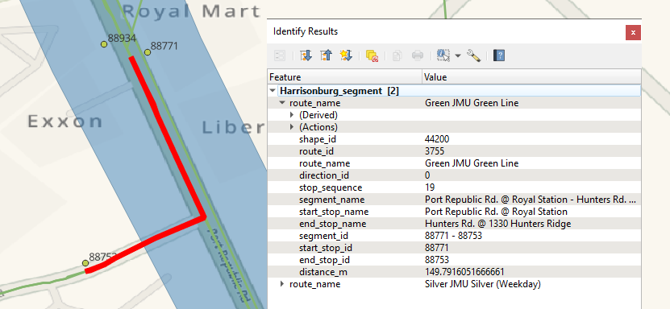
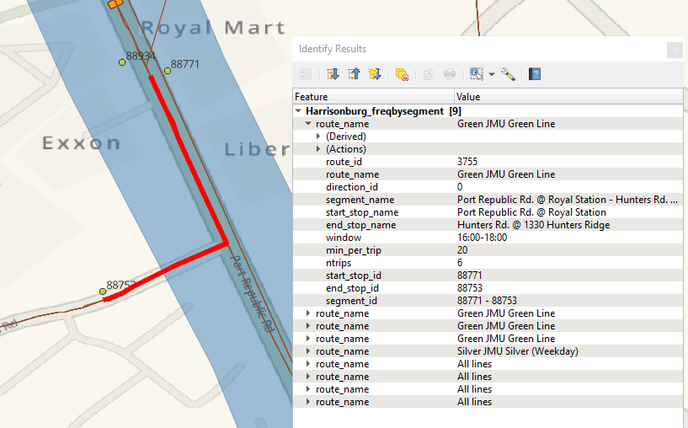
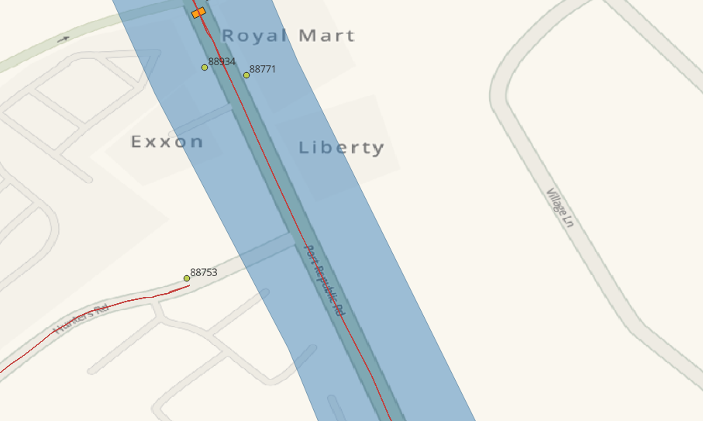
Segment 88771 to 88753 is created.
Segment is exists and the calculations are correct for freq.
Segment is absent in Speeds by segment

