Slide 1
ActivitySim Data Type Optimization Task – Progress Update
Sijia Wang, WSP
AMPO Consortium Meeting, 6/27/2023

Slide 2
Agenda
Strings in ActivitySim
IntEnum
Example of Replacing Strings with IntEnum in ActivitySim
Next Steps

Slide 3
Strings in ActivitySim
Mandatory Tour Scheduling Choosers Table in ARC 25% run
Uses 254 GB of memory
Has five String columns taking over 150 GB of memory
Column Names | Existing Values | String Memory (GB) | Int 64 Memory (GB) | Int 8 Memory (GB)
out_period | EA, AM, MD, PM, EV | 29.7 | 4.0 | 0.5
in_period | EA, AM, MD, PM, EV | 29.7 | 4.0 | 0.5
tour_type | work, school, univ, escort, eatout, … | 30.7 | 4.0 | 0.5
tour_category | mandatory, non-mandatory, joint, atwork | 33.6 | 4.0 | 0.5
mandatory_tour_seg | work, school, univ | 30.7 | 4.0 | 0.5

Slide 4
Strings in ActivitySim
What (Input, Interim, and Output attributes)
Time periods
Persons: cdap, mandatory_tour_frequency, etc.,
Tours: purpose, category, composition, mode, etc.,
Etc.,
Where
Source codes
UECs
Settings
Annotations

Slide 5
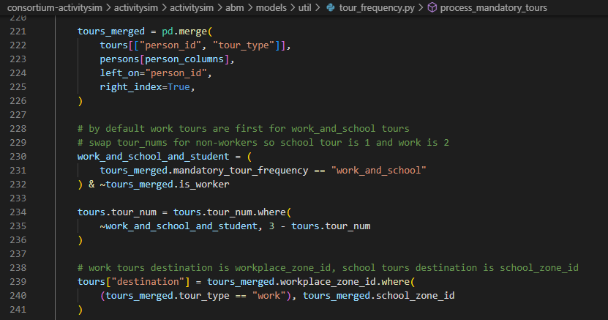
Strings in Source Codes

Slide 6
Strings in UECs

Slide 7
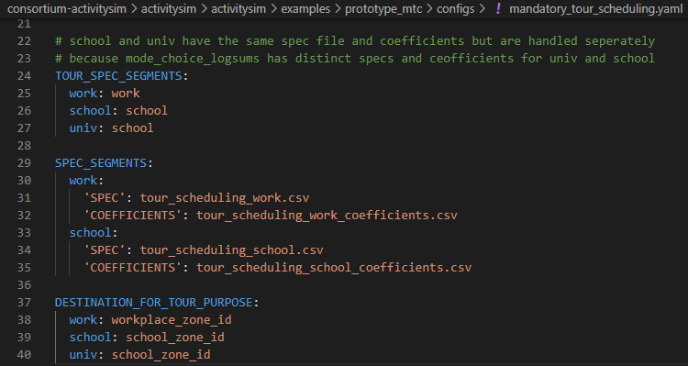
Strings in Settings

Slide 8
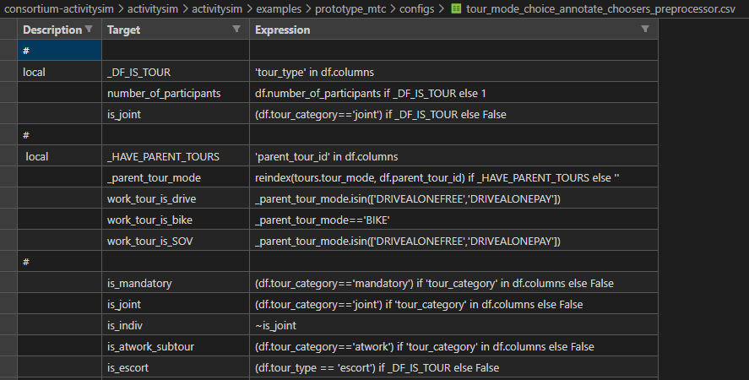
Strings in Annotations

Slide 9
Keep in mind when changing one sub-model, we need to …
Pile through all relevant files (.py, .csv, .yaml, …)
Update downstream sub-models
Next, switching to VS Code to show an example of replacing Strings with IntEnums …

Slide 10
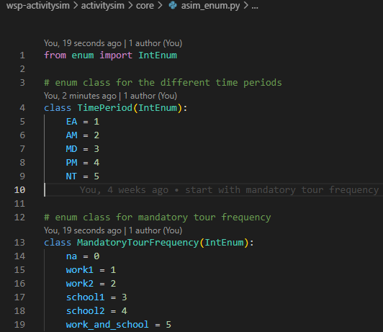
Source code changes

Slide 11
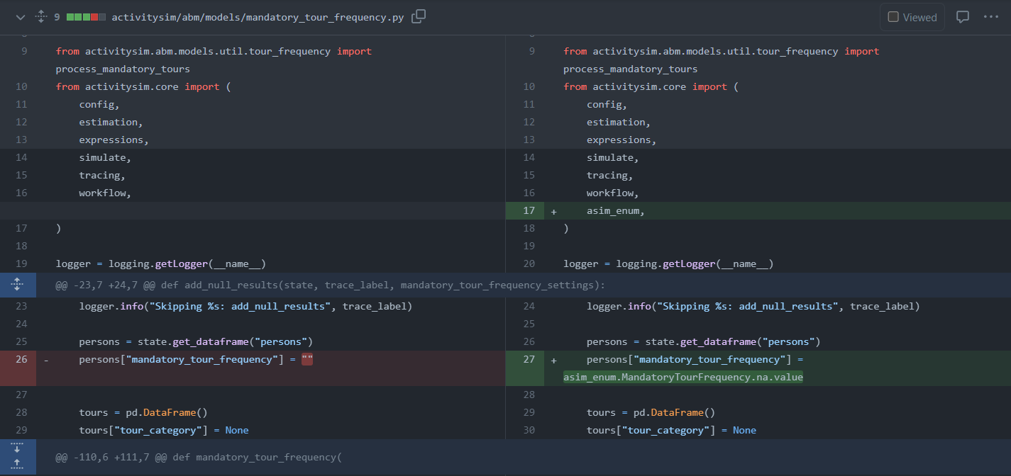
Source code changes

Slide 12
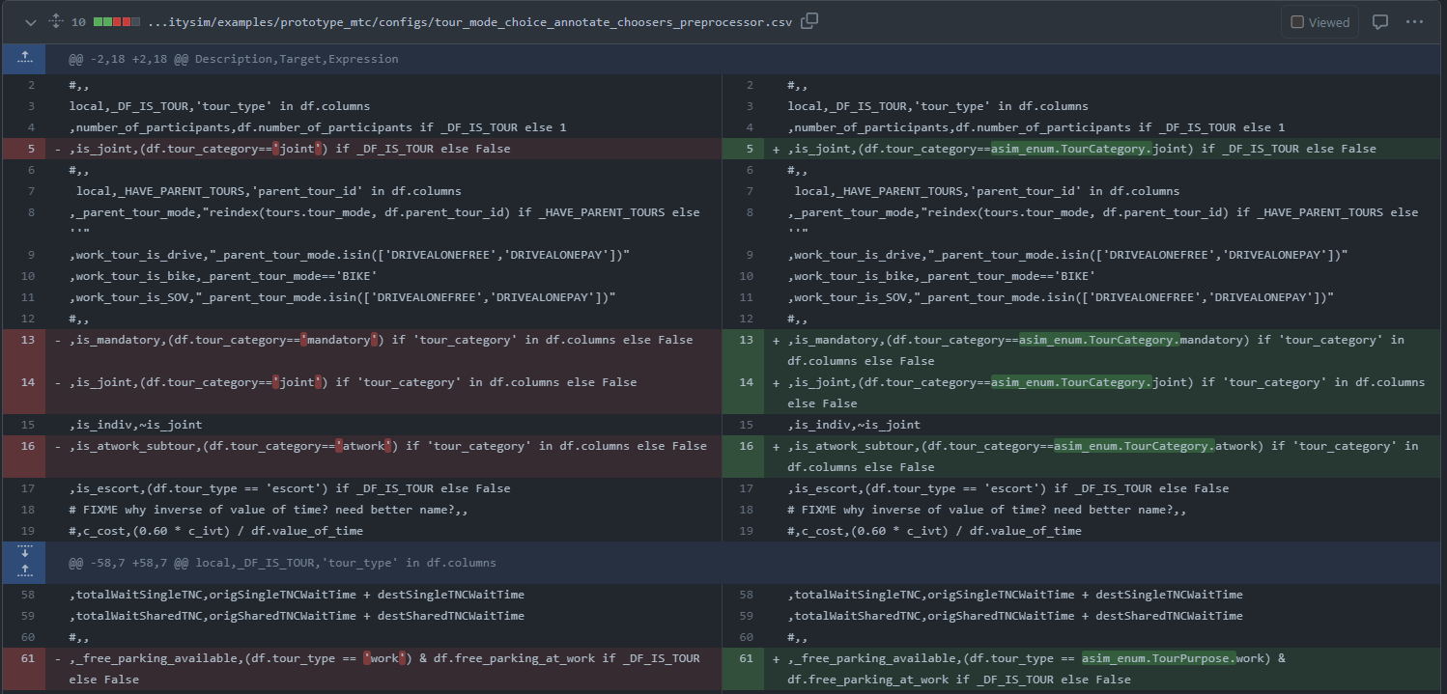
UEC and annotation changes

Slide 13
Memory saving
Mandatory tour scheduling model tour 1 work choosers table memory usage (5000 households)

Slide 14
Next Steps
Look into using Pandas Categorical data type for string variables
Finalize an approach for optimizing string variables
IntEnum vs Pandas Categorical vs something else (?)
Things to consider:
Backward compatibility
Roadmap
Data model
etc.,
Optimize numeric data types (e.g., int 64 vs int 8)
Discuss in 2 weeks

